Slide 2
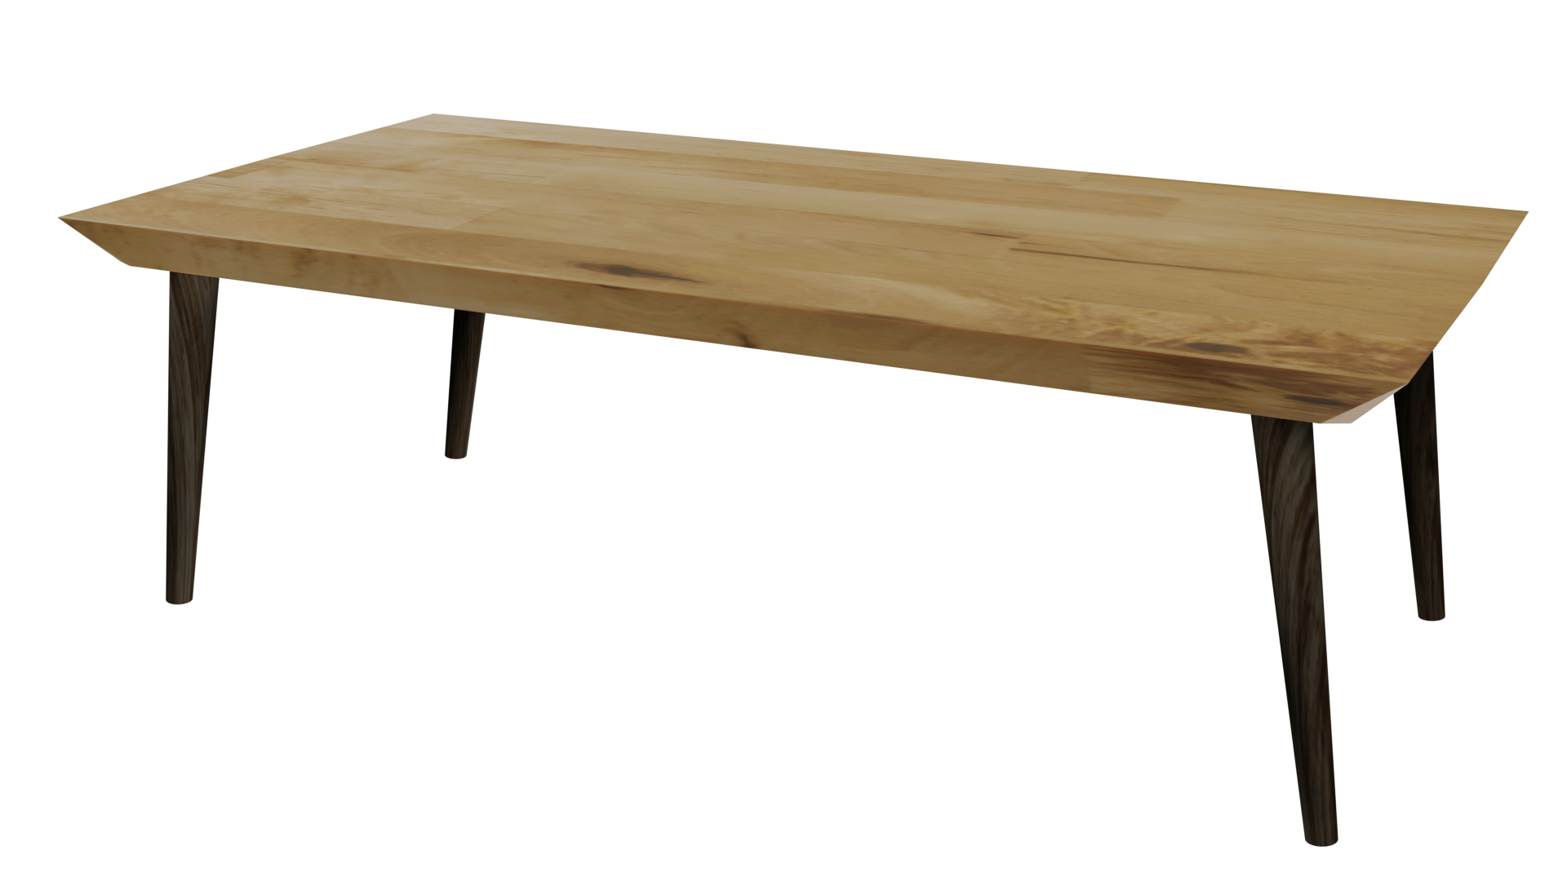
Videos
Welcome to
Worksheets

Slide 3
4-H Pledge
I pledge My Head to clearer thinking,
My Heart to greater loyalty,
My Hands to larger service,
& My Health to better living,
for my club, my community, my country, and my world.

Slide 4
Learn:
Today’s Lesson:
Wanted:
A Good Friend
Activity:

Slide 5
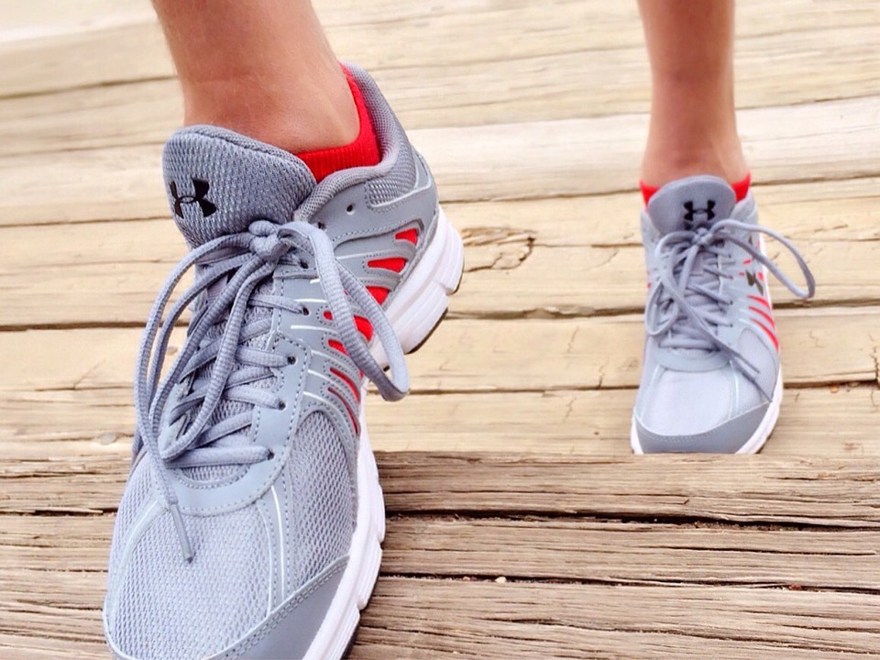
Warmup Time!
Notes:
To get students active at the beginning of the virtual lesson, choose one of the warm-ups from the list.

Slide 6
My Good Qualities
Think of a quality you like in yourself
Introduce yourself and that quality
Example:
“My name is Kara and I am a good listener”
Notes:
Step 1:
Tips:
If using Zoom, have students change their names with the “rename function”. Example “ Kara - Good Listener”

Slide 7
FRIEND:
Notes:
Step 2:
Tips:
If using Zoom, use the annotate function. This allows youth to type or draw freely on your screen.

Slide 8
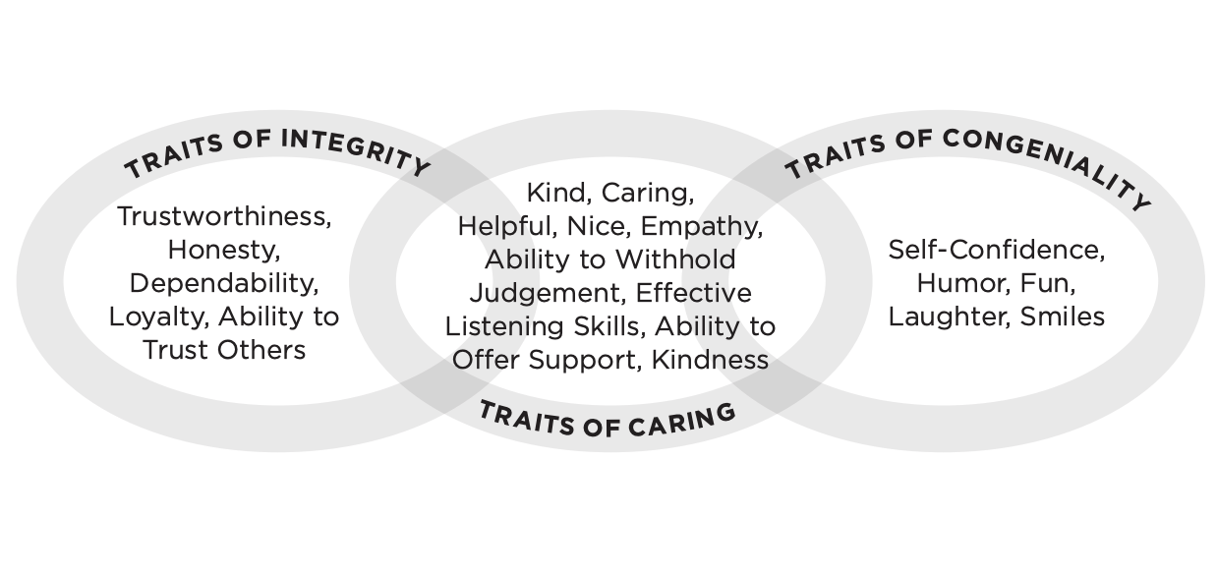
Friendship Links: Qualities of a Good Friend
Notes:
Step 3:
[Modified Activity]: When finished brainstorming, use the handout on this slide called QUALITIES OF A GOOD FRIEND. Discuss with students the importance of integrity, congeniality, and a caring attitude when being a good friend and when making new ones. Conduct a guided discussion with students detailing the qualities that are associated with integrity, congeniality, and a caring attitude. For example, to be a person of integrity, one must be trustworthy and honest. Continue with guided discussion using the QUALITIES OF A GOOD FRIEND student handout as a reference. Check for understanding by asking youth to clarify the qualities of a good friend.
Tips:
This activity was modified so that it could be done without having to have the handout.

Slide 9
Share & Process:
What are some of the most common/prominent words you generated?
What did you notice about the similarities and differences between the list you generated and the list provided on the Qualities of a Good Friend handout?
How would you describe a healthy friendship?
Notes:
Step 4:

Slide 10
Healthy or Unhealthy?
Notes:
Step 5:
Tips:
To motivate students to get up out of their chairs, you can have them jump up and down for healthy or sway from side to side for unhealthy.

Slide 11
Share & Process:
How could you tell if a friendship was healthy or unhealthy?
What was the most difficult part when deciding if the example was a healthy or unhealthy friendship?
How quickly were you able to see the differences in healthy and unhealthy friendships?
Notes:
Step 6:

Slide 12
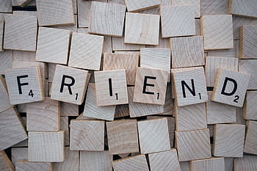
Wanted Ad for a Good Friend
Notes:
Step 7:
[Modified Activity]: Youth have had the chance to apply the qualities of a good friend to real life situations. Using what the youth know about healthy friendships and the qualities of a good friend, youth will create a “want ad” for a good friend. Read the WANT AD FOR A GOOD FRIEND handout to the students. The goal is for each student to complete their own WANT AD FOR A GOOD FRIEND handout on a blank piece of paper containing the following information:
■ Three qualities of a good friend that you are looking for
■ Three personal qualities that you possess that make you a good friend
■ Two activities you like to do
■ A picture to catch the reader’s eye
Remind the students to use the QUALITIES OF A GOOD FRIEND handout as a reference.
Tips:
This activity was modified so that it could be done without having to have the handout.
Step 8:
Step 9:
Step 10:

Slide 13
Family Corner / Community Corner
Notes:
Step 11:

Slide 14
This presentation was developed by North Carolina 4-H for use by the 4-H Health Rocks!® program and its trained facilitators. This content should only be used by those who are authorized by North Carolina 4-H and are trained to implement this program. If you are viewing this information and have not been trained in Health Rocks!®, please contact your local North Carolina 4-H Agent.
For questions regarding the NC 4-H programs, contact your local 4-H Agent.
Click here to find your county center!
For more information about NC 4-H Healthy Living programs, visit our website!
Click here to learn more about North Carolina 4-H Healthy Living.
For questions regarding content related to the NC 4-H Health Rocks!® program, contact the NC 4-H Healthy Living Coordinator.
Kenan Bridges
NC 4-H Healthy Living Coordinator
kbridge3@ncsu.edu

Slide 15
References
1. Rauschenberger, R. (n.d.). [Silhouette of a mother helping her child ride a bicycle]. Pixabay. https://pixabay.com/illustrations/sunset-child-mother-learning-bike-3921616/
2. Wokandapix. (n.d.). [Photograph of scrabble pieces spelling the word friend]. USA. Pixabay. https://pixabay.com/photos/friend-word-scrabble-letters-1820040/

