Slide 2
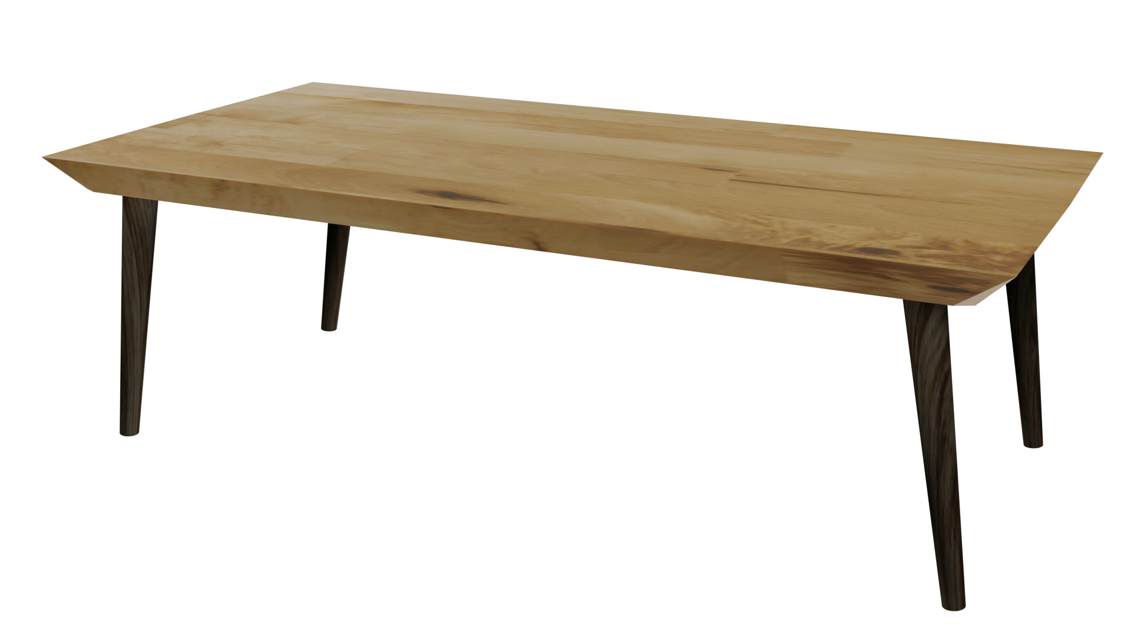
Videos
Welcome to
Worksheets

Slide 3
4-H Pledge
I pledge My Head to clearer thinking,
My Heart to greater loyalty,
My Hands to larger service,
& My Health to better living,
for my club, my community, my country, and my world.

Slide 4
Learn:
Today’s Lesson:
Where Can I Go For Help?
Activity:

Slide 5
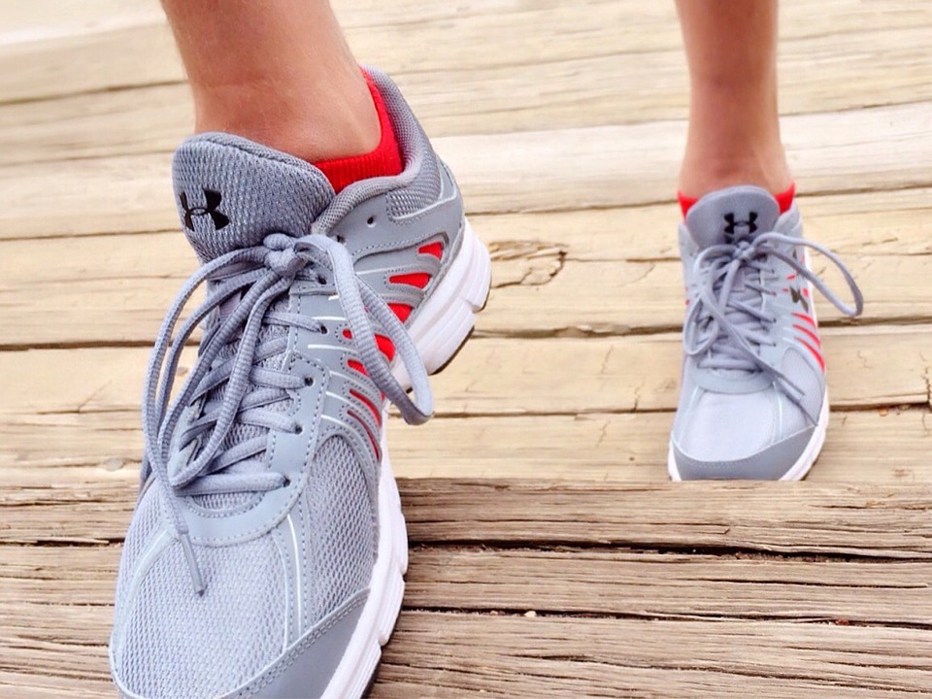
Warmup Time!
Notes:
To get students active at the beginning of the virtual lesson, choose one of the warm-ups from the list.

Slide 6
Everyone Needs Help From Time to Time
Share a time when you needed help from an adult.
Notes:
Step 1:
Tips:
Instead of raising their hands, you can have students nod their head “yes” or jump up and down.
Instead of using a ball, you can call on a student first. That student will then pick the next student to share and so on. For fun, the students can act like they are throwing the “ball” to the next person. The student can pretend to catch the “ball.”

Slide 7
Four Situations:
Situation #1: _____________
Situation #2: _____________
Situation #3: _____________
Situation #4: _____________
Notes:
Step 2:
Tips:
Have each student get out a piece of paper and a pencil. Have students fold their papers in half from top to bottom. On the top half, instruct them to write their four situations on their paper like it is shown above. Remind them to leave space in between each situation. Offer the students the opportunity to share a situation if they so choose.

Slide 8
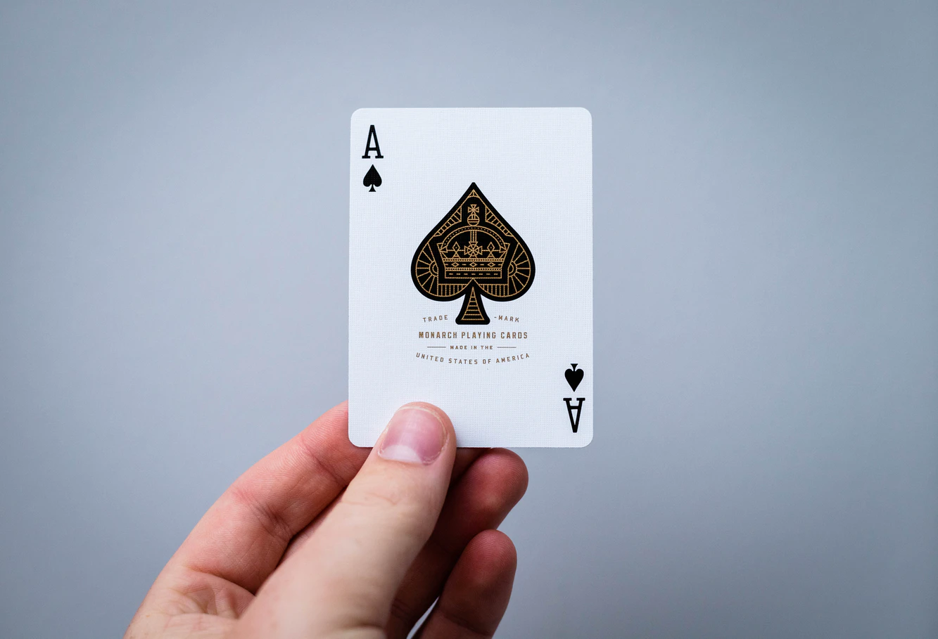
Support Team: Who Is Your ACE?
Notes:
Step 3:
Tips:
If using Zoom, use the annotate feature to record the answers.

Slide 9
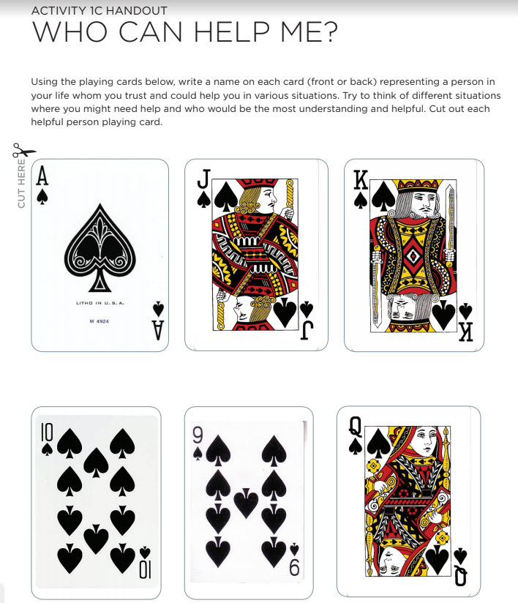
Playing Cards
Notes:
Step 4:
Tips:
On the bottom half of the page, instruct the students to build their support team by writing down a different “helpful adult” for each card shown on this powerpoint slide.
Step 5:
Tips:
Have the students write their helpful adults next to or below the situation in which that adult would be most helpful.
Step 6:
Tips:
You can select a student to share first, and then they would select the next student (and so on). For fun, the students can act like they are throwing the “ball” to the next person.
Step 7:
Step 8:

Slide 10
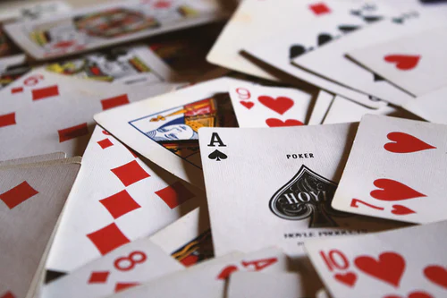
Family Corner / Community Corner
Notes:
Step 9:

Slide 11
This presentation was developed by North Carolina 4-H for use by the 4-H Health Rocks!® program and its trained facilitators. This content should only be used by those who are authorized by North Carolina 4-H and are trained to implement this program. If you are viewing this information and have not been trained in Health Rocks!®, please contact your local North Carolina 4-H Agent.
For questions regarding the NC 4-H programs, contact your local 4-H Agent.
Click here to find your county center!
For more information about NC 4-H Healthy Living programs, visit our website!
Click here to learn more about North Carolina 4-H Healthy Living.
For questions regarding content related to the NC 4-H Health Rocks!® program, contact the NC 4-H Healthy Living Coordinator.
Kenan Bridges
NC 4-H Healthy Living Coordinator
kbridge3@ncsu.edu

Slide 12
References
1. Wokandapix. (n.d.). [Photograph of tennis shoes]. USA. Pixabay. https://pixabay.com/photos/run-running-sport-fitness-healthy-750466/
2. Rauschenberger, R. (n.d.). [Silhouette of a mother helping her child ride a bicycle]. Pixabay. https://pixabay.com/illustrations/sunset-child-mother-learning-bike-3921616/
3. Thought Catalog. (n.d.). Taking notes with a pencil [Photograph]. Unsplash. https://unsplash.com/photos/RdmLSJR-tq8
4. Porada, W. (n.d.). [Photograph of a hand holding an ace card]. Unsplash. https://unsplash.com/photos/VrDwCA1W7IM
5. Hamilton, J. (n.d.). Lily, rosemary, and the ace of spades [Photograph]. Unsplash. https://unsplash.com/photos/9SewS6lowEU

