Slide 2
Videos
Welcome to
Worksheets

Slide 3
4-H Pledge
I pledge My Head to clearer thinking,
My Heart to greater loyalty,
My Hands to larger service,
& My Health to better living,
for my club, my community, my country, and my world.

Slide 4
Learn:
Today’s Lesson:
Is It Worth The Risk?
Activity:

Slide 5
Review
What did we learn last time?
Notes:
Step 1:

Slide 6
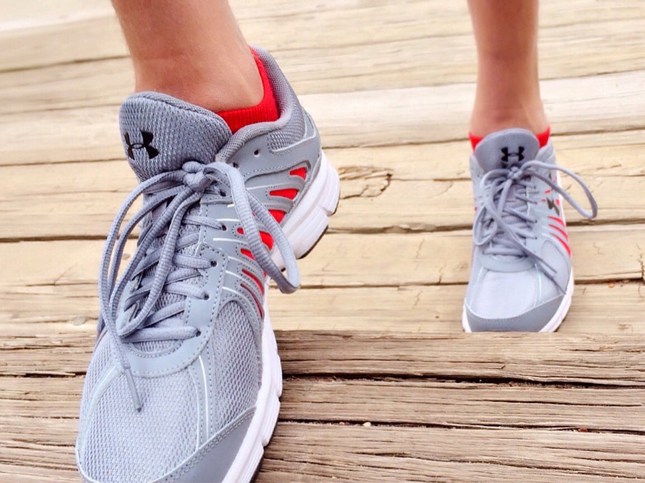
Warmup Time!
Notes:
To get students active at the beginning of the virtual lesson, choose one of the warm-ups from the list.

Slide 7
Cause & Consequence
Notes:
Step 2:

Slide 8
Activity #1
Notes:
Step 3:
Tips:
If they have the supplies at home, you can tell them to do this activity with you or on their own time. If they do not have the materials, they can watch you do the activity. If students do not have molasses, honey could be used as a second option. If they are doing this individually, they may want to consider using half a cup of molasses instead of one cup.
Step 4:
Step 5:

Slide 9
Activity #2
Notes:
Step 6:
Tips:
To keep track of how many students got right, have them make tally marks at the top of their paper or check marks beside the words.
Step 7:
Tips:
You can turn on loud music while you read the list of words. Get the students to suggest a clean song that you will play (make sure it is clean). You could also have all of the students turn on their microphones and start talking as you read the list of words.
Step 8:

Slide 10
Activity #3
Notes:
Step 9:
Tips:
If the students have unlined paper, you can have the students draw the bullseye and the “X.” They can also use the bullseye on this slide and the “X” on the next slide.
Step 10:
Tips:
Be prepared to quickly go to the the next slide with the “X.”

Slide 11
x
Notes:
Step 10:
Step 11:
Step 12:

Slide 12
Family Corner / Community Corner
Notes:
Step 13:

Slide 13
This presentation was developed by North Carolina 4-H for use by the 4-H Health Rocks!® program and its trained facilitators. This content should only be used by those who are authorized by North Carolina 4-H and are trained to implement this program. If you are viewing this information and have not been trained in Health Rocks!®, please contact your local North Carolina 4-H Agent.
For questions regarding the NC 4-H programs, contact your local 4-H Agent.
Click here to find your county center!
For more information about NC 4-H Healthy Living programs, visit our website!
Click here to learn more about North Carolina 4-H Healthy Living.
For questions regarding content related to the NC 4-H Health Rocks!® program, contact the NC 4-H Healthy Living Coordinator.
Kenan Bridges
NC 4-H Healthy Living Coordinator
kbridge3@ncsu.edu

Slide 14
References
1. Lachmann-Anke, P., & Lachmann-Anke, M. (n.d.). [Animated person with question marks]. Pixabay. https://pixabay.com/illustrations/question-mark-consider-think-2318030/
2. Wokandapix. (n.d.). [Photograph of tennis shoes]. USA. Pixabay. https://pixabay.com/photos/run-running-sport-fitness-healthy-750466/
3. Şahin, D. (n.d.). Barely breathing [Photograph]. Adana, Turkey. Unsplash. https://unsplash.com/photos/Wddj9jJFb6k
4. Proctor, R. (n.d.). [Photograph of cannabis]. Los Angeles, CA. Unsplash. https://unsplash.com/photos/PGc9Vid8O24
5. Langford, S. (n.d.). Sweet honey in a jar [Photograph]. Charlotte, NC. Unsplash. https://unsplash.com/photos/RQHzRELE2Ss
6. Lyons, T. (n.d.). [Photograph of tar]. Unsplash. https://unsplash.com/photos/dYiI3vghmec

