Slide 2
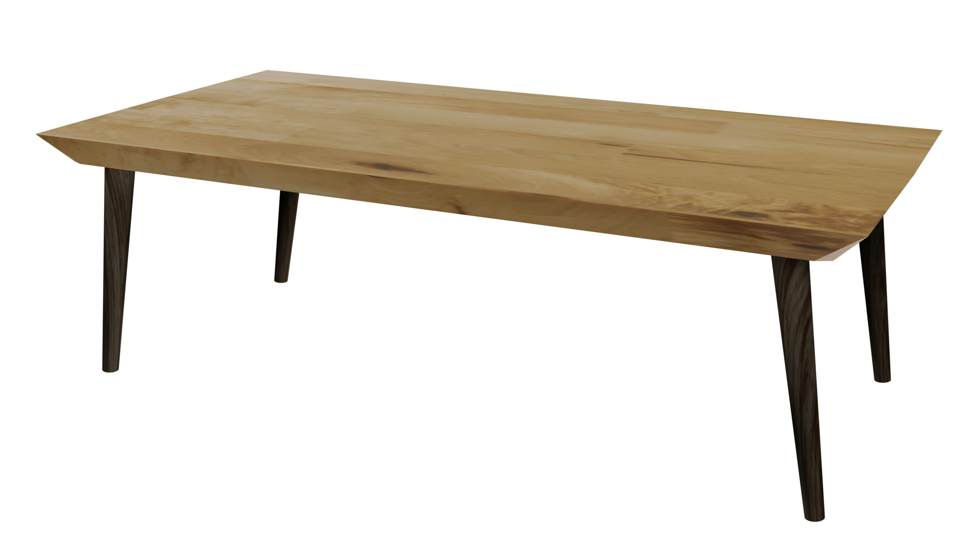
Videos
Welcome to
Worksheets

Slide 3
4-H Pledge
I pledge My Head to clearer thinking,
My Heart to greater loyalty,
My Hands to larger service,
& My Health to better living,
for my club, my community, my country, and my world.

Slide 4
Learn:
Today’s Lesson:
Can You Ever Have Too Much?
Activity:

Slide 5
Review
What did we learn last time?
Notes:
Step 1:

Slide 6
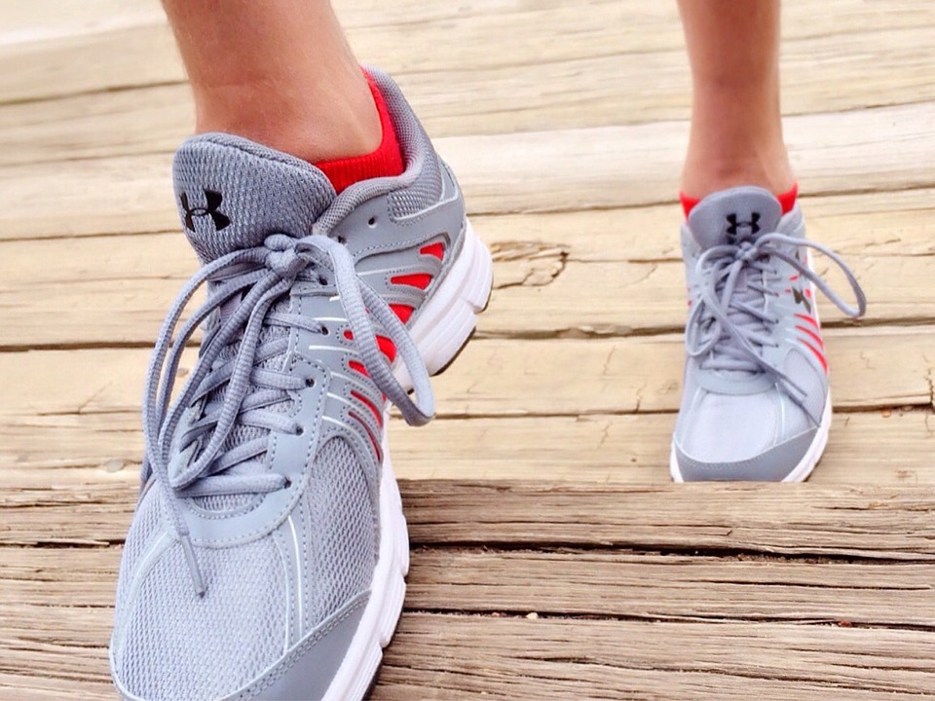
Warmup Time!
Notes:
To get students active at the beginning of the virtual lesson, choose one of the warm-ups from the list.

Slide 7
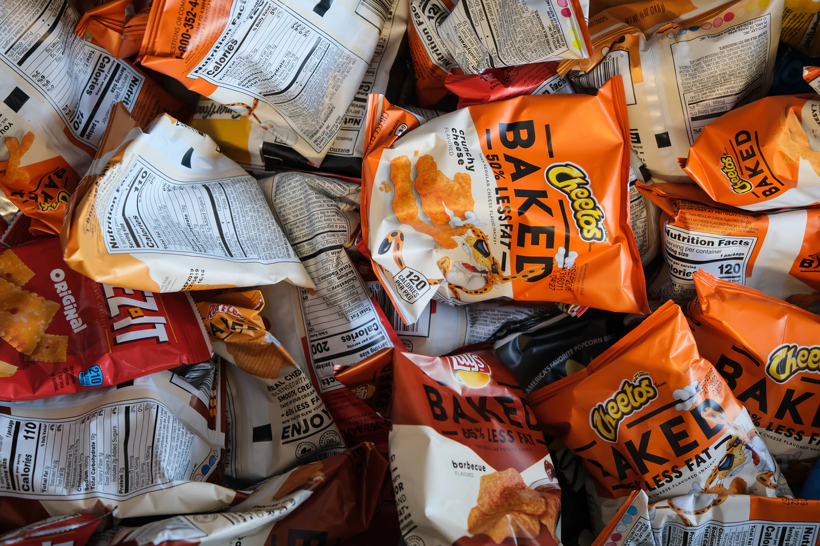
Can You Ever Have Too Much Of A Good Thing?
Notes:
Step 2:
Step 3:
[Modified Activity] Share with students that they’ve all come down with an imaginary illness and the only cure is to eat five pieces of their favorite snack (ex: chips, goldfish, carrots, apples, popcorn, chocolate, etc.). With their caregivers’ permission, have the students put ten pieces of their favorite snack in a bowl or on a plate. Allow students to take their doses. Move on through the next activity.
Tips:
This activity was modified so that it can still be done in a virtual setting.

Slide 8
Activity:
Notes:
Step 4:
Step 5:
Tips:
Have students do this activity individually.

Slide 9
How Many Do You Have Left?
Notes:
Step 6:
Step7:
[Modified Activity]
SHARE:
■ What was the purpose of the snack activity?
■ How can the snack activity be related to opioid abuse?
PROCESS:
■ Why do people abuse opioids?
■ Why are opioids commonly abused?
■ Is it okay to use someone else’s prescription?
■ Is it okay to take more than the prescribed dosage of a medication?
GENERALIZE AND APPLY:
■ If someone you know abuses opioids, who can you turn to for help?
■ How would abusing any drug affect family and work?
■ If someone abuses opioids, how would you feel about spending
time with them?
Tips:
The questions were modified so that they would match the modified snack activity.
Step 8:
Tips:
[Note] There is a typo in the curricula. Step 13 will follow step 8.

Slide 10
Family Corner / Community Corner
Notes:
Step 13:

Slide 11
This presentation was developed by North Carolina 4-H for use by the 4-H Health Rocks!® program and its trained facilitators. This content should only be used by those who are authorized by North Carolina 4-H and are trained to implement this program. If you are viewing this information and have not been trained in Health Rocks!®, please contact your local North Carolina 4-H Agent.
For questions regarding the NC 4-H programs, contact your local 4-H Agent.
Click here to find your county center!
For more information about NC 4-H Healthy Living programs, visit our website!
Click here to learn more about North Carolina 4-H Healthy Living.
For questions regarding content related to the NC 4-H Health Rocks!® program, contact the NC 4-H Healthy Living Coordinator.
Kenan Bridges
NC 4-H Healthy Living Coordinator
kbridge3@ncsu.edu

Slide 12
References
1. Lachmann-Anke, P., & Lachmann-Anke, M. (n.d.). [Animated person with question marks]. Pixabay. https://pixabay.com/illustrations/question-mark-consider-think-2318030/
2. Wokandapix. (n.d.). [Photograph of tennis shoes]. USA. Pixabay. https://pixabay.com/photos/run-running-sport-fitness-healthy-750466/
3. Quintal, R. (n.d.). Baked chips and other bags of reduced fat junk food [Photograph]. Unsplash. https://unsplash.com/photos/GEpzcRu5QGA
4. Sikkema, K. (n.d.). Design work [Photograph]. Boston, MA. Unsplash. https://unsplash.com/photos/cXkrqY2wFyc
5. Olszewski, T. (n.d.). Raw blackberries just from the garden [Photograph]. Pisz, Poland. Unsplash. https://unsplash.com/photos/4s7zbRR43As
6. Scheid, M. (n.d.). Fathers and daughters [Photograph]. La Paz, Mexico. Unsplash. https://unsplash.com/photos/0iqkntLw93A

