Slide 2
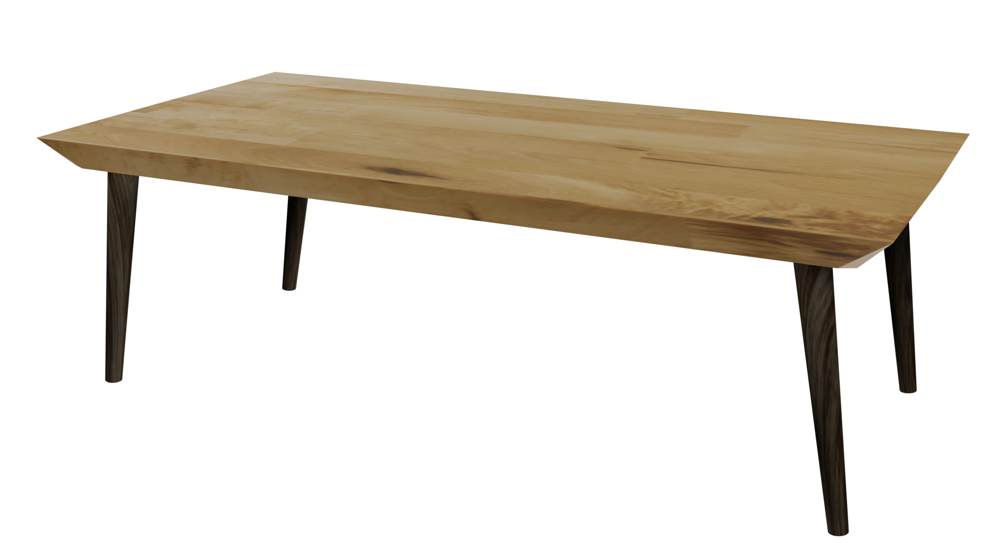
Videos
Welcome to
Worksheets

Slide 3
4-H Pledge
I pledge My Head to clearer thinking,
My Heart to greater loyalty,
My Hands to larger service,
& My Health to better living,
for my club, my community, my country, and my world.

Slide 4
Learn:
Today’s Lesson:
I Can Do It!
Activity:

Slide 5
Review
What did we learn last time?
Notes:
Step 1:

Slide 6
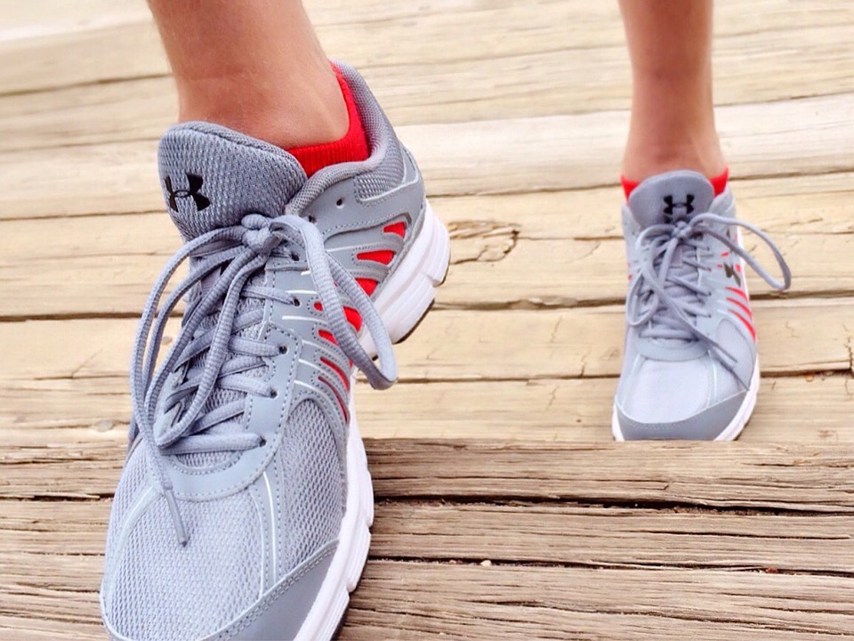
Warmup Time!
Notes:
To get students active at the beginning of the virtual lesson, choose one of the warm-ups from the list.

Slide 7
Self Efficacy
Notes:
Step 2:

Slide 8
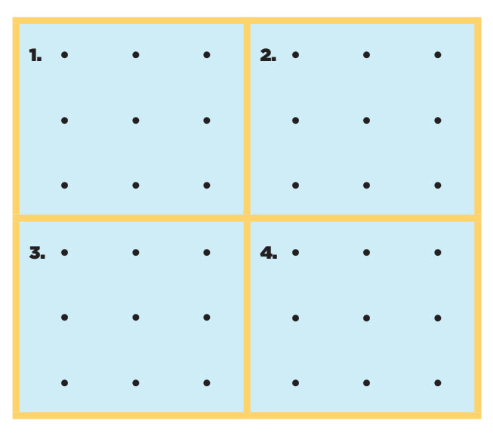
Is It Possible?
Without lifting your pencil, draw through all nine dots using only four straight lines.
Notes:
Step 3:
Tips:
Ask students to fold a piece of paper into fourths and draw the dots as shown on the slide.Then give them the directions for this activity.

Slide 9
How Did You Do?
Was Anyone Successful?
Notes:
Step 4:
Step 5:
Tips:
If using Zoom, use the annotate function so that the student can demonstrate how to complete the activity.

Slide 10
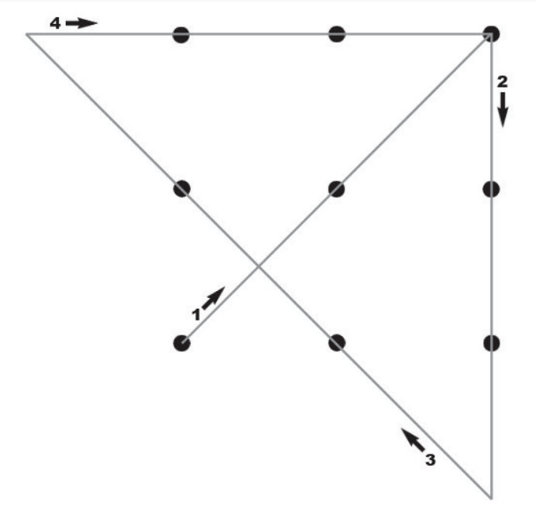
It Is Possible!
Notes:
Step 5:

Slide 11
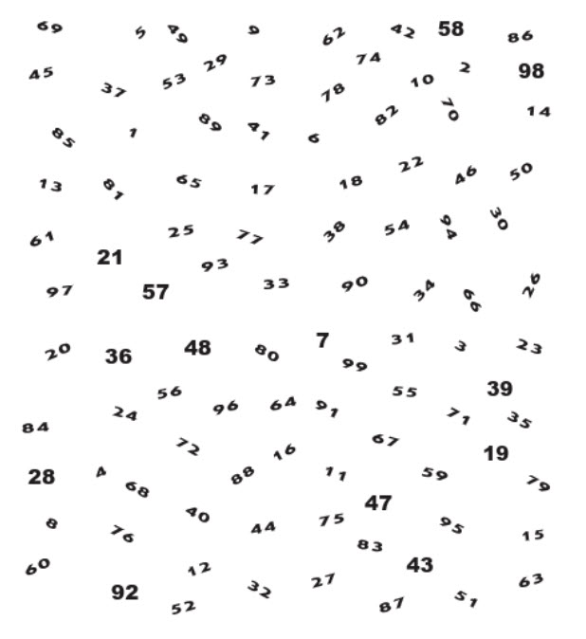
It’s In The Numbers
Notes:
Step 6:
Tips:
You can have them use the copy on the screen, and point to the numbers with their finger or cursor.
Step 7:

Slide 12
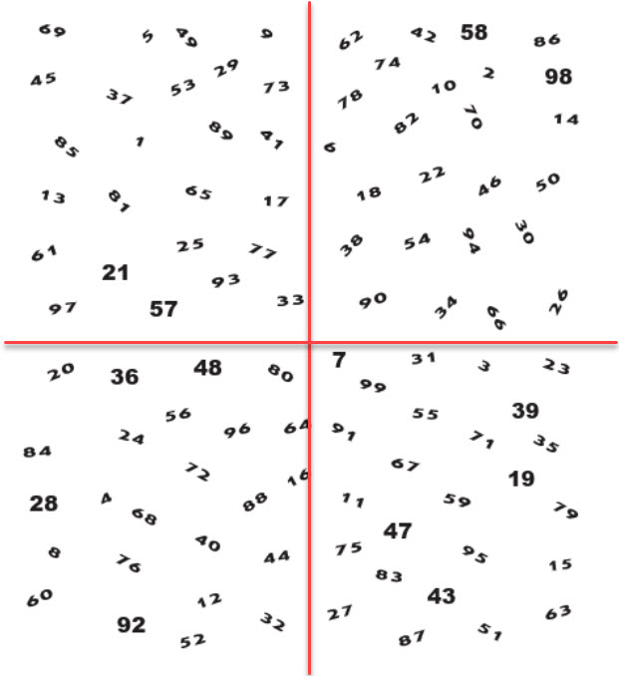
It’s In The Numbers
Notes:
Step 8:
Tips:
You can have the students use the copy on the screen that is divided into fourths. They can point to the numbers with their finger or cursor.
Step 9:
Step 10:
Step 11:

Slide 13
Family Corner / Community Corner
Notes:
Step 13:

Slide 14
This presentation was developed by North Carolina 4-H for use by the 4-H Health Rocks!® program and its trained facilitators. This content should only be used by those who are authorized by North Carolina 4-H and are trained to implement this program. If you are viewing this information and have not been trained in the Health Rocks!®, please contact your local North Carolina 4-H Agent.
For questions regarding the NC 4-H programs, contact your local 4-H Agent.
Click here to find your county center!
For more information about NC 4-H Healthy Living programs, visit our website!
Click here to learn more about North Carolina 4-H Healthy Living.
For questions regarding content related to the NC 4-H Health Rocks!® program, contact the NC 4-H Healthy Living Coordinator.
Kenan Bridges
NC 4-H Healthy Living Coordinator
kbridge3@ncsu.edu

Slide 15
References
1. Lachmann-Anke, P., & Lachmann-Anke, M. (n.d.). [Animated person with question marks]. Pixabay. https://pixabay.com/illustrations/question-mark-consider-think-2318030/
2. Wokandapix. (n.d.). [Photograph of tennis shoes]. USA. Pixabay. https://pixabay.com/photos/run-running-sport-fitness-healthy-750466/
3. Gauster, H. (n.d.). You’ve got your work cut out for you [Photograph]. Graz, Austria. Unsplash.https://unsplash.com/photos/3y1zF4hIPCg
4. Teirlinck, M. (n.d.). Celebrating the party boy with confetti! [Photograph]. Beernem, Belgium. Unsplash. https://unsplash.com/photos/WLlW03JZGBE
5. Sikkema, K. (n.d.). Design work. [Photograph]. Unsplash. https://unsplash.com/photos/cXkrqY2wFyc

