Slide 2
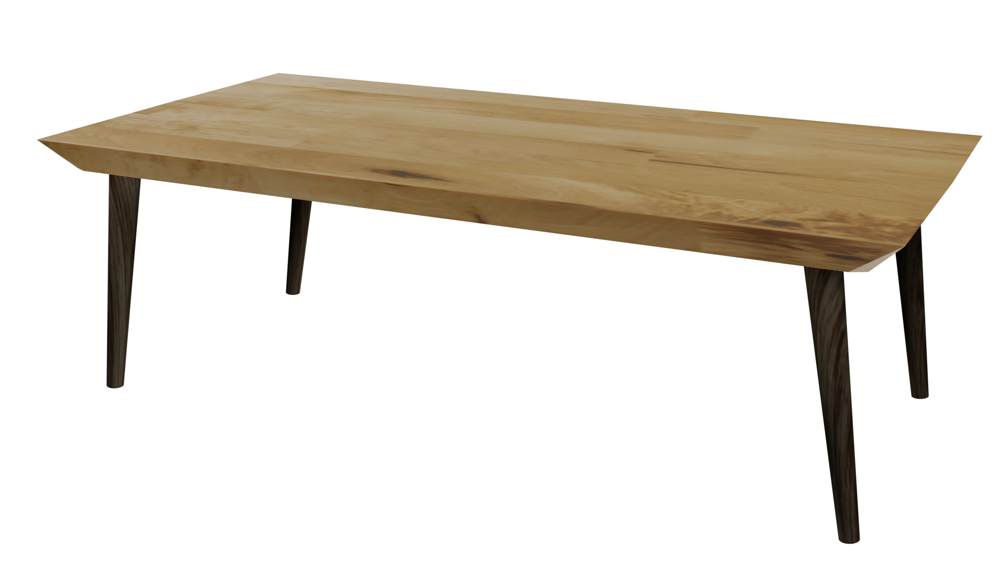
Videos
Welcome to
Worksheets

Slide 3
4-H Pledge
I pledge My Head to clearer thinking,
My Heart to greater loyalty,
My Hands to larger service,
& My Health to better living,
for my club, my community, my country, and my world.

Slide 4
Learn:
Today’s Lesson:
All Stressed Out
Activity:

Slide 5
Review
What did we learn last time?
Notes:
Step 1:

Slide 6
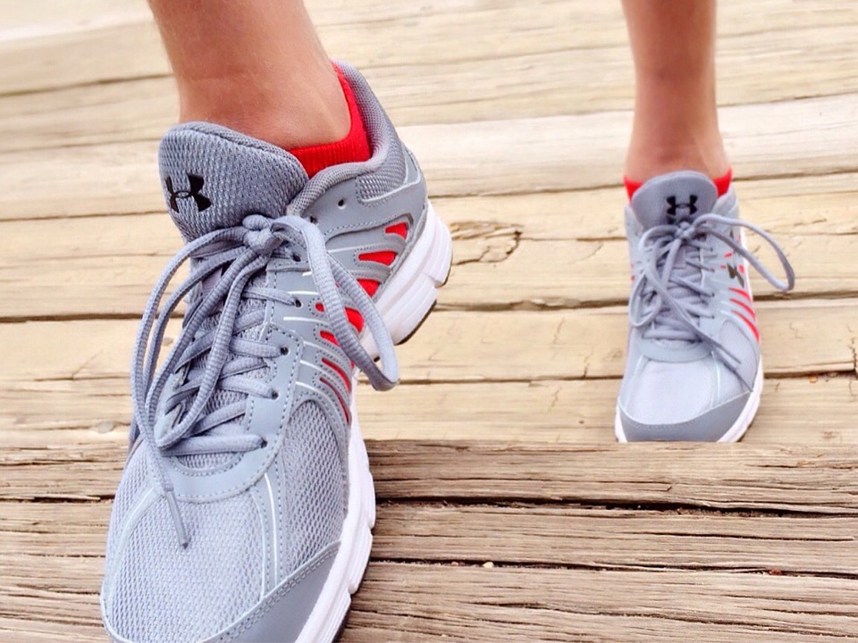
Warmup Time!
Notes:
To get students active at the beginning of the virtual lesson, choose one of the warm-ups from the list.

Slide 7
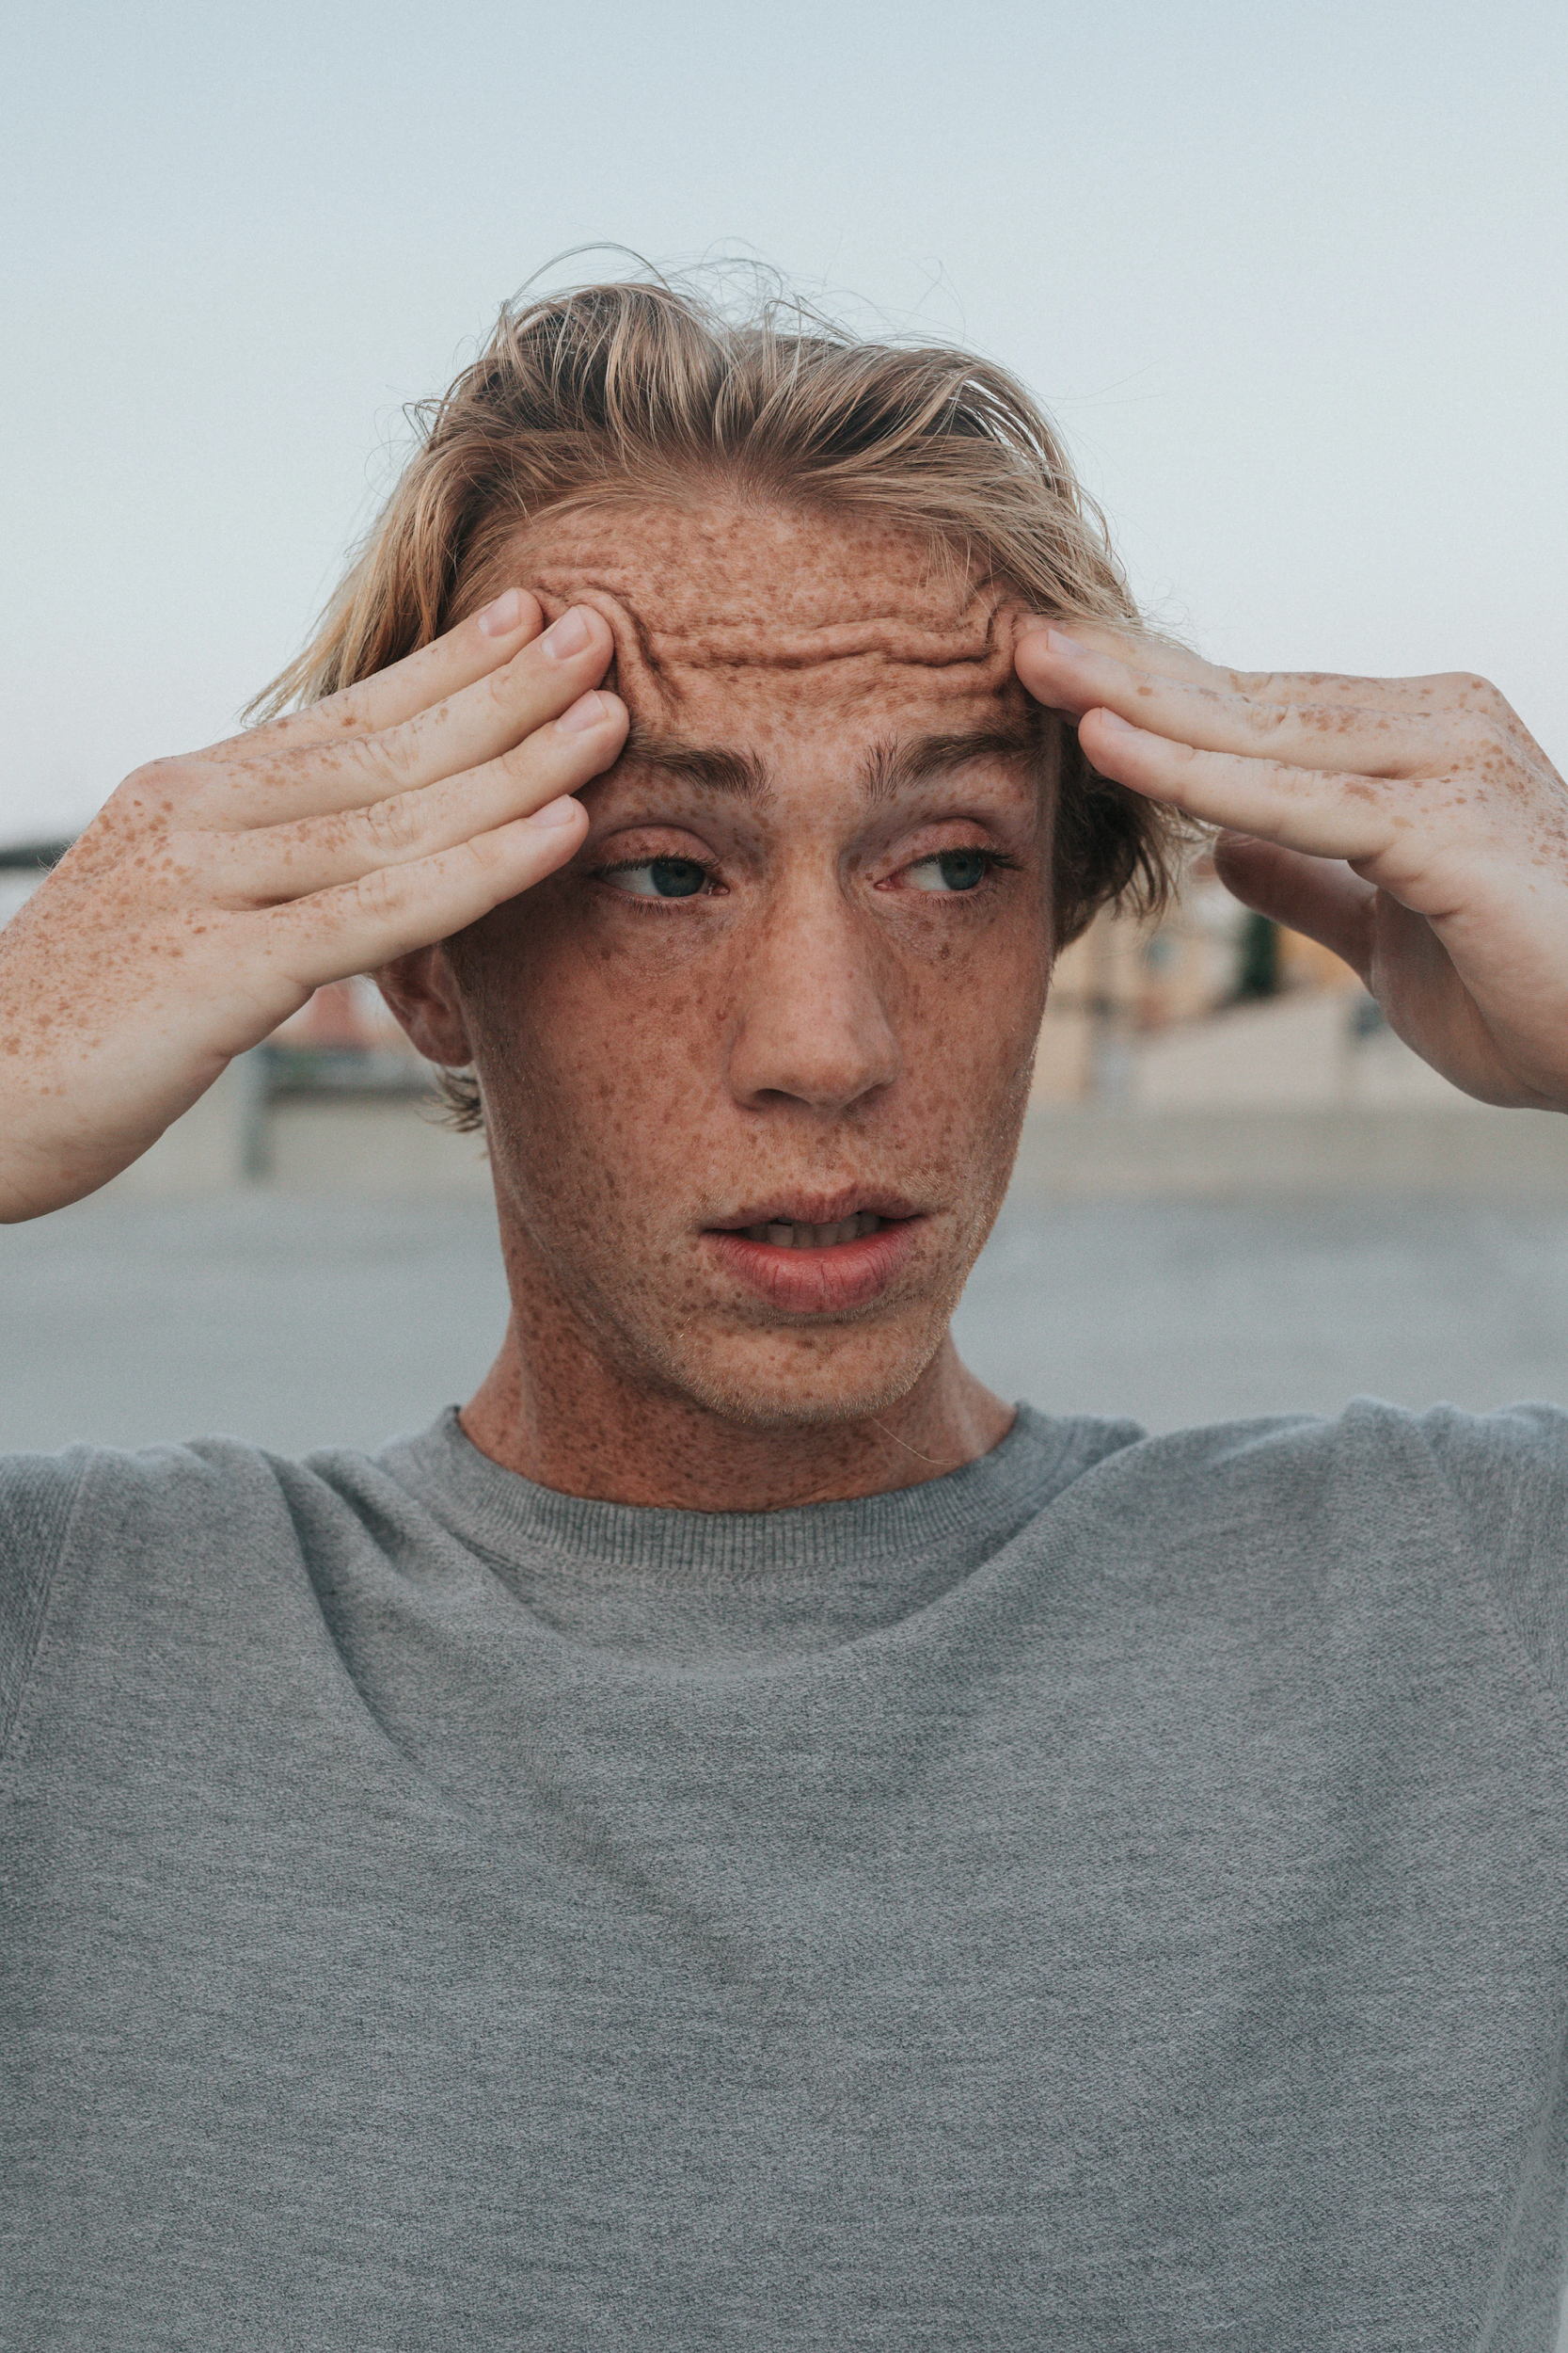
Stress
Notes:
Step 2:
Tips:
If using Zoom, you can use the annotate feature to record their answers.
Step 3:

Slide 8
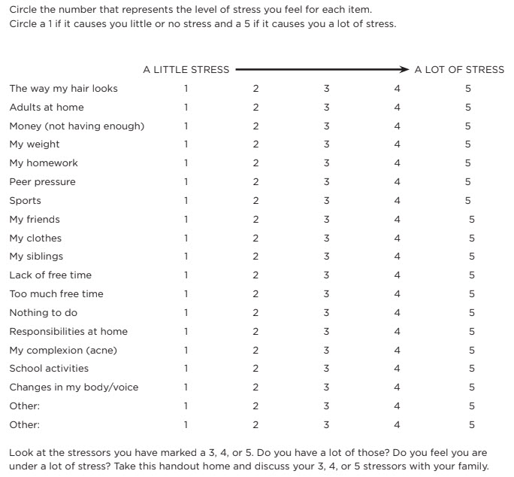
What is Causing my Stress?
Notes:
Step 4:
[Modified Activity] Using the WHAT IS CAUSING MY STRESS? Handout on this slide, read each scenario aloud and have the students write their level of stress caused by each item on a piece of paper.
Tips:
This activity was modified so that the activity could still be done without having the handout.
Step 5:
[Modified Activity] Instruct students to get two small cups from their kitchen and some paper towels. Tell students to fill both cups halfway full with water. Tell students that one of the cups of water represents them. Make sure to remind students to not get too close to the computer because we don’t want any water to accidentally spill on their computer.
Tips:
This activity was modified so that it could be done without having the materials.
Step 6:
[Modified Activity] Read each of the stressors on the WHAT IS CAUSING MY STRESS? Handout on this slide. For each stressor, ask participants to pour a splash of water from one of the cups to the other cup for every point in the score. For example, three splashes for a score of three.
Tips:
This activity was modified so that it could be done without having the materials.
Step 7:
SHARE:
■ How might the cup having water poured into it represent a person who has stress in their life, or a person who might be adding more stress to their life?
■ If someone is not getting rid of some stress, what might happen?
■ How is your body going to feel when stress builds up?
Tips:
This activity was modified so that the questions would correspond to the modified activities in the previous steps.

Slide 9
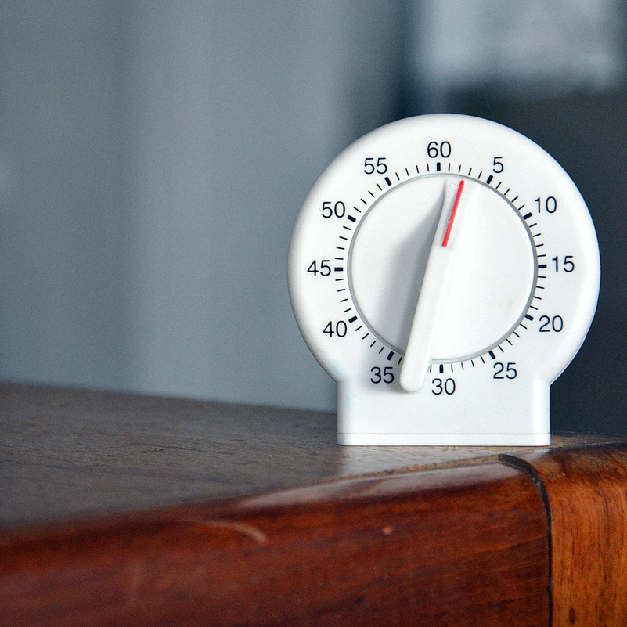
Activity
Notes:
Step 8:
Step 9:
[Modified Activity] To highlight the feeling of stress, even in a fun situation, have the youth participate in this activity. Tell the group that they are going to take part in a scavenger hunt in their house. Explain to them that the goal of the activity is to find the selected item and return to the computer before the timer goes off. There will be several rounds. Each round, you will set the timer for less time. If the student doesn’t make it back to the computer with the item before the timer goes off, they will have to stand with there hands on their head. This will help the students still feel included. They will have to do this for the rest of the game. The last item will be specifically challenging in order to simulate the feeling of stress. The order of the object and the time limit that the students have is listed below:
30 seconds--a pillow
25 seconds--something that is in the shape of a circle
20 seconds--something orange
15 seconds--a black notebook
Tips:
This activity was modified so that students could still experience the feeling of stress in a fun way while participating virtually.
Step 10:
[Modified Activity]
SHARE:
■ How did you feel as you tried to make it back to the computer before the timer was up?
■ What were some of the physical symptoms of stress that you experienced?
■ If you didn’t find the item before the time was up, how did you feel?
Tips:
This activity was modified so that the questions would correspond to Step 9.

Slide 10
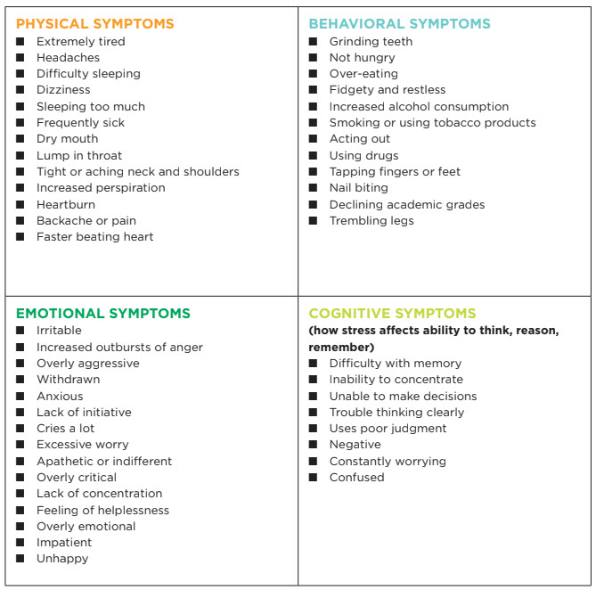
Symptoms of Stress
Notes:
Step 11:
[Modified Activity] Have students fold a piece of paper into fourths. Tell students to label each fourth with the headings shown in the SYMPTOMS OF STRESS Handout. Have students write down which symptoms of stress (it can be both mild and extreme stress) they experience under the corresponding heading. When they have finished, have them write an “X” by those symptoms they experience when they feel a lot of stress. Ask them to share and discuss those.
Tips:
This activity was modified so that it could be done with having the handout.
Step 12:
Step 13:

Slide 11
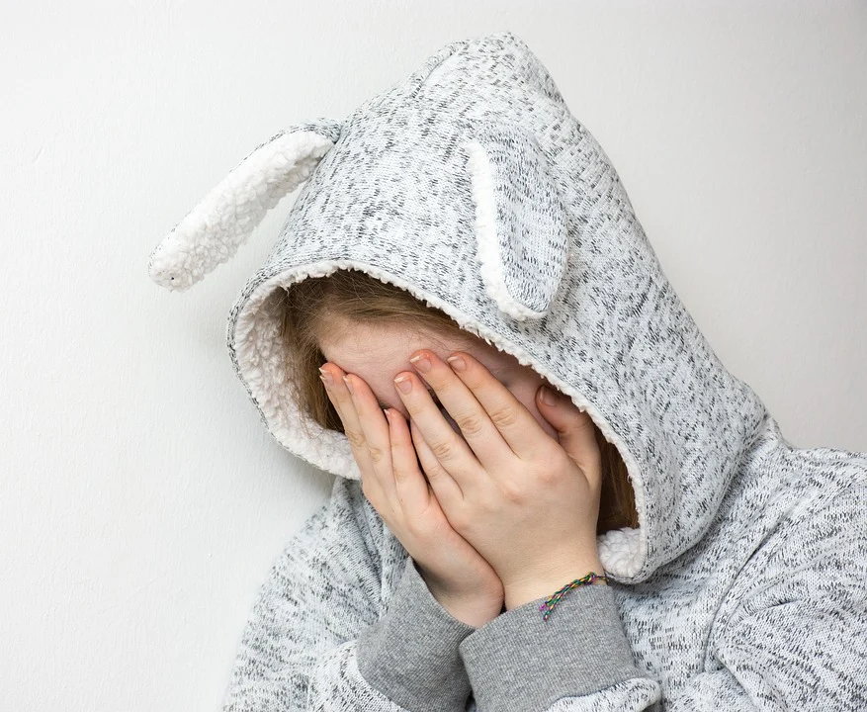
Family Corner / Community Corner
Notes:
Step 14:

Slide 12
This presentation was developed by North Carolina 4-H for use by the 4-H Health Rocks!® program and its trained facilitators. This content should only be used by those who are authorized by North Carolina 4-H and are trained to implement this program. If you are viewing this information and have not been trained in Health Rocks!®, please contact your local North Carolina 4-H Agent.
For questions regarding the NC 4-H programs, contact your local 4-H Agent.
Click here to find your county center!
For more information about NC 4-H Healthy Living programs, visit our website!
Click here to learn more about North Carolina 4-H Healthy Living.
For questions regarding content related to the NC 4-H Health Rocks!® program, contact the NC 4-H Healthy Living Coordinator.
Kenan Bridges
NC 4-H Healthy Living Coordinator
kbridge3@ncsu.edu

Slide 13
References
1. Lachmann-Anke, P., & Lachmann-Anke, M. (n.d.). [Animated person with question marks]. Pixabay. https://pixabay.com/illustrations/question-mark-consider-think-2318030/
2. Wokandapix. (n.d.). [Photograph of tennis shoes]. USA. Pixabay. https://pixabay.com/photos/run-running-sport-fitness-healthy-750466/
3. Dumlao, N. (n.d.). [Photograph of a boy with his hands on his forehead]. Los Angeles, CA. Unsplash. https://unsplash.com/photos/rWJ2RthM-gc
4. Leal, M. (n.d.). Time [Photograph]. Rio Grande do Sul, Brasil. Unsplash. https://unsplash.com/photos/vZawEq0Eexo
5. Anemone123. (n.d.). [Photograph of a girl wearing a hood with bunny ears]. Austria. Pixabay. https://pixabay.com/photos/desperate-sad-depressed-cry-2040598/

