Slide 2
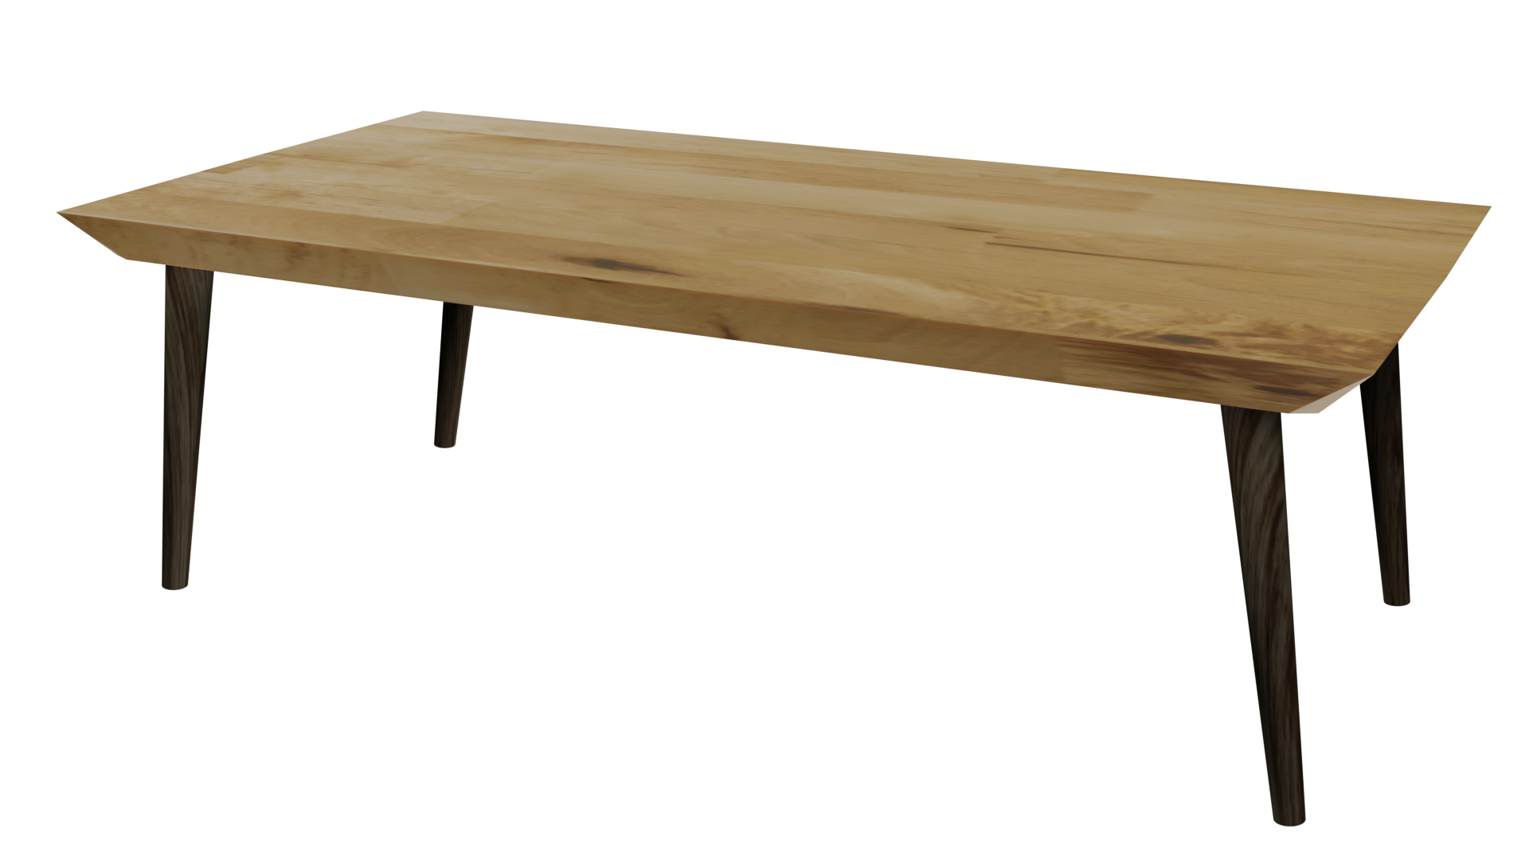
Videos
Welcome to
Worksheets

Slide 3
4-H Pledge
I pledge My Head to clearer thinking,
My Heart to greater loyalty,
My Hands to larger service,
& My Health to better living,
for my club, my community, my country, and my world.

Slide 4
Learn:
Today’s Lesson:
SMART Goals
Activity:

Slide 5
Review
What did we learn last time?
Notes:
Step 1:

Slide 6
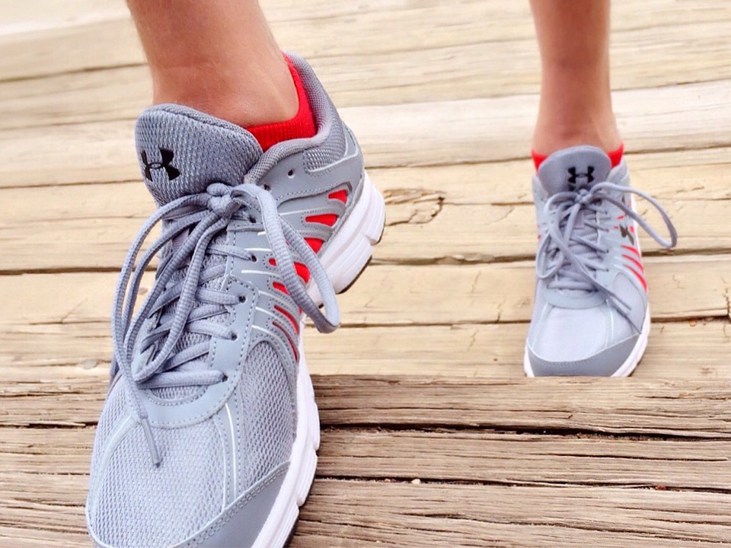
Warmup Time!
Notes:
To get students active at the beginning of the virtual lesson, choose one of the warm-ups from the list.

Slide 7
Goals
Notes:
Step 2:
Step 3:

Slide 8
SMART Goals
Specific - What do you want to accomplish?
Measurable - How will you know you are getting close to reaching the goal?
Attainable - Is this a goal you can achieve?
Realistic - Do you have the willingness and ability to reach this goal?
Timely - Is there a timeline for reaching the goal?
Notes:
Step 4:

Slide 9
What Are Your Greatest Dreams?
Notes:
Step 5:
Tips:
Have students draw the cloud from the handout on a piece of paper.
Step 6:
Step 7:
[Modified Activity] Encourage some of the students to share one of their goals. Make sure they do not reveal what kind of goal it is. Have the rest of the students determine whether it is a short-term, intermediate, or long-term goal, and give one step that can be taken to accomplish that goal.
Tip:
This activity was modified so that students could do the activity in a virtual setting.
[Note] There is a typo in the curricula. Step 9 will follow step 7.
Step 9:
[Modified Activity] Go back to the goals that were discussed in Step 7. For each goal, have participants discuss how getting caught vaping, getting picked up for alcohol or drug possession, or being addicted to alcohol or drugs will impact reaching the goal. Remind youth that losing control and losing inhibitions because of substance use and abuse impact decision-making. Do you think people consider the impact their behaviors will have on reaching their goals? Why or why not?
Tips:
This activity was modified so that it would correspond to the previous step.

Slide 10
Activity
Notes:
Step 10:
[Modified Activity] One important factor in setting and reaching healthy goals is to regularly remind yourself of your goals and the steps needed to reach your goals. For this next activity, youth will be creating an individual picture of their goals! Have each youth pick their most important SMART goal. It can be short, intermediate, or long-term. On a piece of paper, youth should write the goal and then draw some type of picture representing that goal. After youth are finished, have each youth share their goal. Give a power clap (one single clap in unison) following each goal. Have students hang their picture somewhere in their house to continuously remind them of their goals!
Tips:
This activity was modified so that it could be an individual activity that could be done virtually.
Step 11:
Step 12:

Slide 11
Family Corner / Community Corner
Notes:
Step 13:

Slide 12
This presentation was developed by North Carolina 4-H for use by the 4-H Health Rocks!® program and its trained facilitators. This content should only be used by those who are authorized by North Carolina 4-H and are trained to implement this program. If you are viewing this information and have not been trained in Health Rocks!®, please contact your local North Carolina 4-H Agent.
For questions regarding the NC 4-H programs, contact your local 4-H Agent.
Click here to find your county center!
For more information about NC 4-H Healthy Living programs, visit our website!
Click here to learn more about North Carolina 4-H Healthy Living.
For questions regarding content related to the NC 4-H Health Rocks!® program, contact the NC 4-H Healthy Living Coordinator.
Kenan Bridges
NC 4-H Healthy Living Coordinator
kbridge3@ncsu.edu

Slide 13
References
1. Lachmann-Anke, P., & Lachmann-Anke, M. (n.d.). [Animated person with question marks]. Pixabay. https://pixabay.com/illustrations/question-mark-consider-think-2318030/
2. Wokandapix. (n.d.). [Photograph of tennis shoes]. USA. Pixabay. https://pixabay.com/photos/run-running-sport-fitness-healthy-750466/
3. Nusetti, S. (n.d.). [Photograph of a globe]. Puppalguda, Hyderabad, India. Unsplash. https://unsplash.com/photos/9tmrYLRL7Ww
4. Varga, J. (n.d.). [Photograph of someone using colored pencils at a desk ]. Slovakia. Unsplash. https://pixabay.com/photos/school-draw-drawing-education-1974369/
5. Tumisu. (n.d.). [Photograph of someone’s arm and hand holding a microphone]. Pixabay. https://pixabay.com/photos/interview-microphone-mic-media-4799256/

