Slide 2
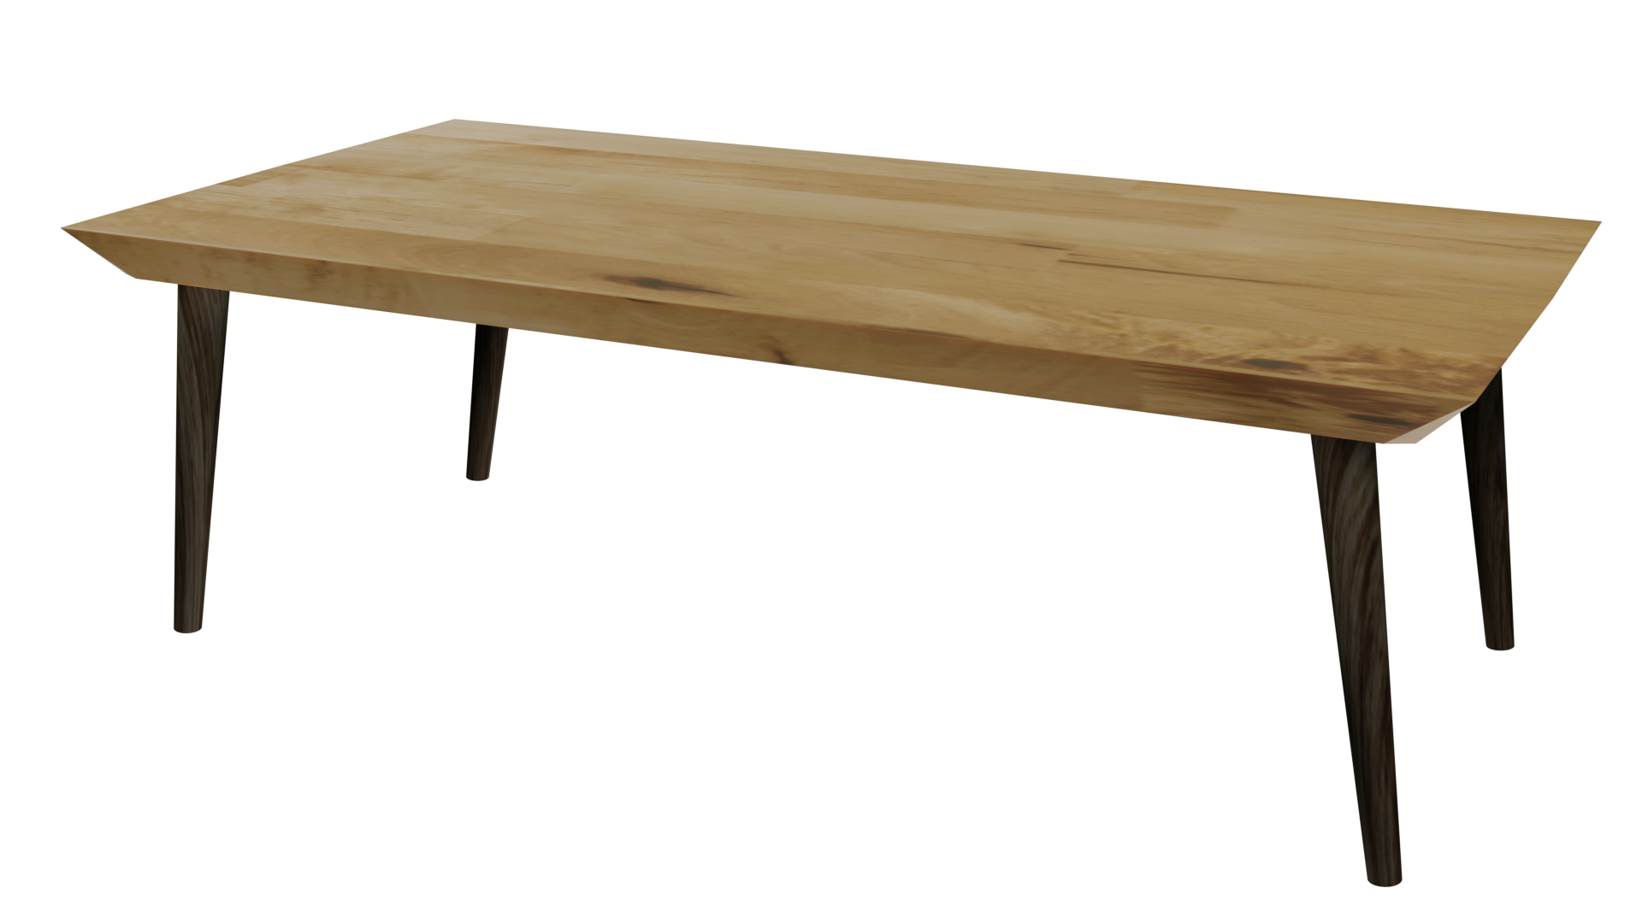
Videos
Welcome to
Worksheets

Slide 3
4-H Pledge
I pledge My Head to clearer thinking,
My Heart to greater loyalty,
My Hands to larger service,
& My Health to better living,
for my club, my community, my country, and my world.

Slide 4
Learn:
Today’s Lesson:
What Do I Believe?
Activity:

Slide 5
Review
What did we learn last time?
Notes:
Step 1:

Slide 6
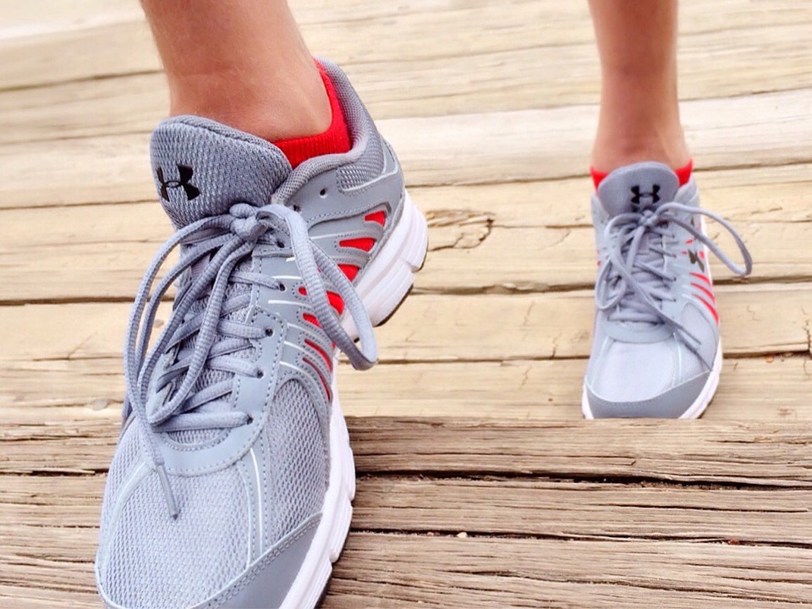
Warmup Time!
Notes:
To get students active at the beginning of the virtual lesson, choose one of the warm-ups from the list.

Slide 7
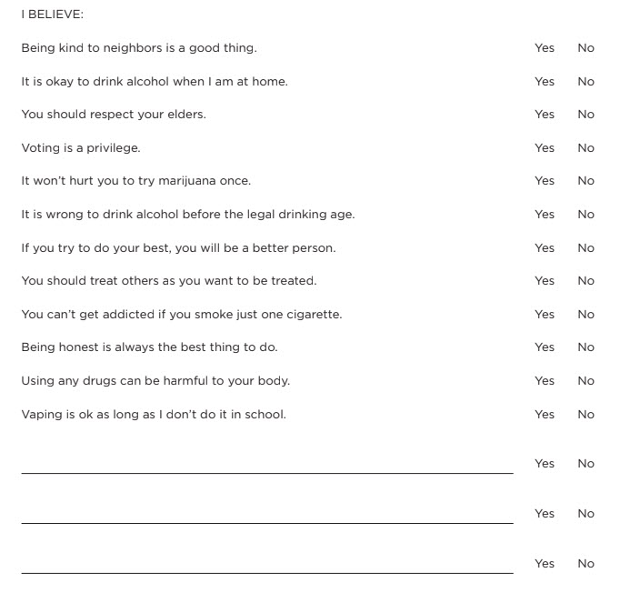
What Do I Believe?
Notes:
Step 2:
[Modified Activity] Show the students the WHAT DO I BELIEVE? Handout on this slide. Explain that this is a list of statements that could make up part of what they value or believe. Have youth write down on a piece of paper some of the statements that they do and do not believe. Instruct youth to think about what else they value or believe and write them on their paper.
Tips:
This activity was modified so that it could be done without having the handout.
Step 3:
Step 4:
Step 5:

Slide 8
Activity
Notes:
Step 6:
Tips:
If using Zoom, you can use the annotate feature to record the belief statements that the group comes up with.
Step 7:
Have each student select several of the belief statements about tobacco, alcohol, or other drugs and individually make a poster to be displayed at school, in the community, or around their house.
Tips:
This activity was modified so that it could be done individually.

Slide 9
Activity
Notes:
Step 8:
Step 9:
[Modified Activity] Have students get a piece of paper or a ball and locate a solid wall/door and a couch nearby. Explain to students that the piece of paper or ball represents them and their value or belief. The students, the wall/door, and the couch represent the negative and positive support they get from those who influence them - parents. friends, peers, teachers, etc.
Tips:
This activity was modified so that it could be done in a virtual setting.
Step 10:
Have students go to their solid wall/door with their piece of paper or ball. When you count to three, have students push the piece of paper or ball against the wall/door. The pressure of the student and the wall/door are equally balanced so the piece of paper or ball is not moving. This means that they are not necessarily getting pressured one way or the other; therefore, they can make their own decisions based on what they believe.
Tips:
This activity was modified so that it could be done in a virtual setting.
Step 11:
Now have the students go to their couch. On the count of three, have them push the piece of paper or ball against the cushioned couch.
Tips:
This activity was modified so that it could be done in a virtual setting.
Step 12:
SHARE:
■ Why is it important to think about what you believe in?
■ What happened when you pushed the piece of paper or ball against the wall/door and the couch?
■ What was the purpose of that activity?
PROCESS:
■ How can what you believe influence you?
■ Was it easy or difficult to distinguish what your beliefs were or if your beliefs were influenced by others? Why?
■ If this were a group of friends wanting you to try vaping or use marijuana, how would it feel?
■ You consider trying a beer because someone wants you to. Your parents and your friends are represented by the force of you pushing against the couch and are pressuring you. How would it feel?
GENERALIZE AND APPLY:
■ How does the paper/ball activity help you when choosing friends?
■ Are you always a positive influence and support? Why or why not?
Tips:
These questions were modified to correspond to the modified activity.
Step 13:

Slide 10
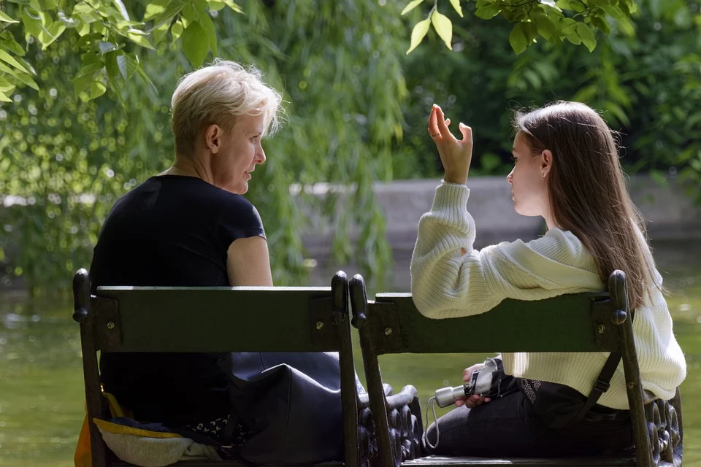
Family Corner / Community Corner
Notes:
Step 14:
[Modified Activity] Discuss the “Family Corner” and “Community Corner” with participants. Encourage them to do one or both. If they choose to do something as a group, help them follow through.
■ Family Corner: Share the paper/ball activity with your family. Share with them some of the belief statements that you wrote down from the WHAT DO I BELIEVE? Handout. Ask your parents what their values and beliefs are and how those beliefs influence their choices.
■ Community Corner: Have youth select a place where they can hang their belief statement posters about tobacco, alcohol, and other drugs. Discuss why it is important to let others know what you value and believe.
Tips:
This activity was modified so that it would correspond to the other modified activities.

Slide 11
This presentation was developed by North Carolina 4-H for use by the 4-H Health Rocks!® program and its trained facilitators. This content should only be used by those who are authorized by North Carolina 4-H and are trained to implement this program. If you are viewing this information and have not been trained in Health Rocks!®, please contact your local North Carolina 4-H Agent.
For questions regarding the NC 4-H programs, contact your local 4-H Agent.
Click here to find your county center!
For more information about NC 4-H Healthy Living programs, visit our website!
Click here to learn more about North Carolina 4-H Healthy Living.
For questions regarding content related to the NC 4-H Health Rocks!® program, contact the NC 4-H Healthy Living Coordinator.
Kenan Bridges
NC 4-H Healthy Living Coordinator
kbridge3@ncsu.edu

Slide 12
References
1. Lachmann-Anke, P., & Lachmann-Anke, M. (n.d.). [Animated person with question marks]. Pixabay. https://pixabay.com/illustrations/question-mark-consider-think-2318030/
2. Wokandapix. (n.d.). [Photograph of tennis shoes]. USA. Pixabay. https://pixabay.com/photos/run-running-sport-fitness-healthy-750466/
3. Netmaru. (n.d.). [Photograph of an art pad and writing utensils]. Seoul, South Korea. Pixabay. https://pixabay.com/photos/pink-macaroon-sketchbook-2187216/
4. Cagle, B. (n.d.). [Photograph of a girl pushing against a wall]. Lawrence, KS. Unsplash. https://unsplash.com/photos/2u459Ux8bto
5. Mircea. (n.d.). [Photograph of a mother and daughter talking on a bench]. Bucharest, Romania. Pixabay https://pixabay.com/photos/people-female-girl-long-hair-woman-5231919/

