Slide 2
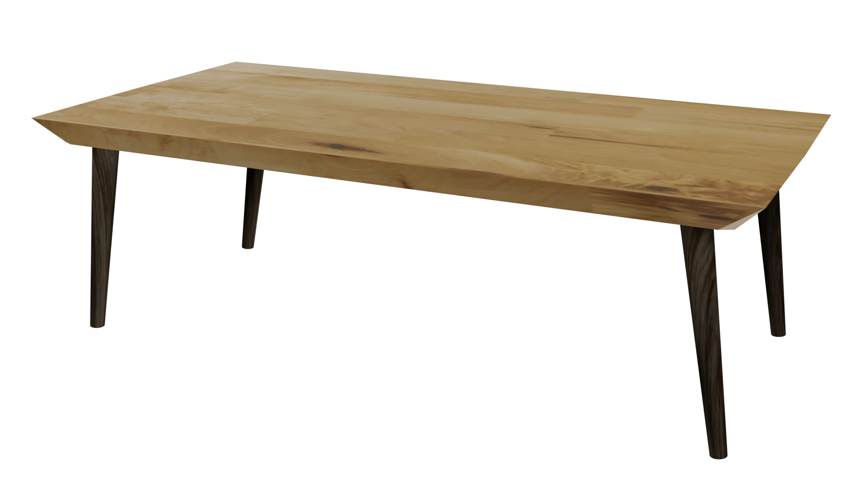
Videos
Welcome to
Worksheets

Slide 3
4-H Pledge
I pledge My Head to clearer thinking,
My Heart to greater loyalty,
My Hands to larger service,
& My Health to better living,
for my club, my community, my country, and my world.

Slide 4
Learn:
Today’s Lesson:
That’s How I Feel
Activity:

Slide 5
Review
What did we learn last time?
Notes:
Step 1:

Slide 6
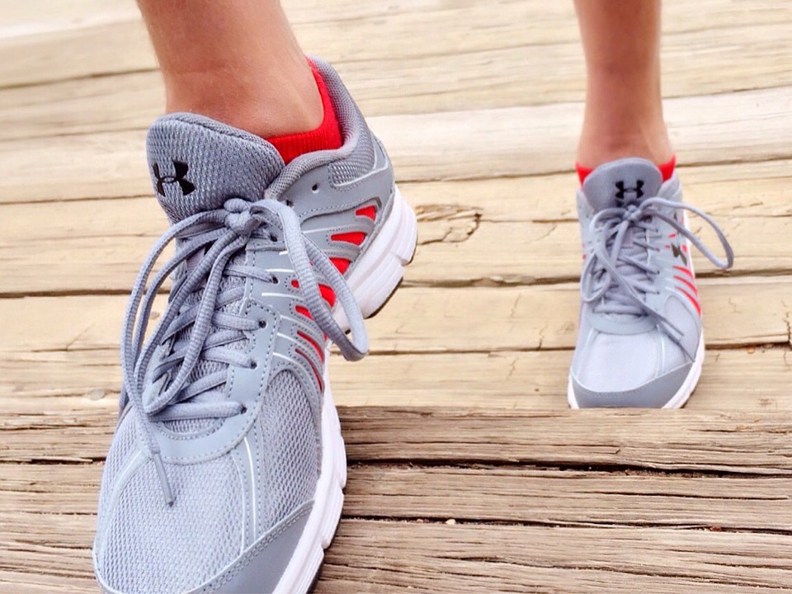
Warmup Time!
Notes:
To get students active at the beginning of the virtual lesson, choose one of the warm-ups from the list.

Slide 7
What Did You Do Last Week?
Notes:
Step 2:

Slide 8
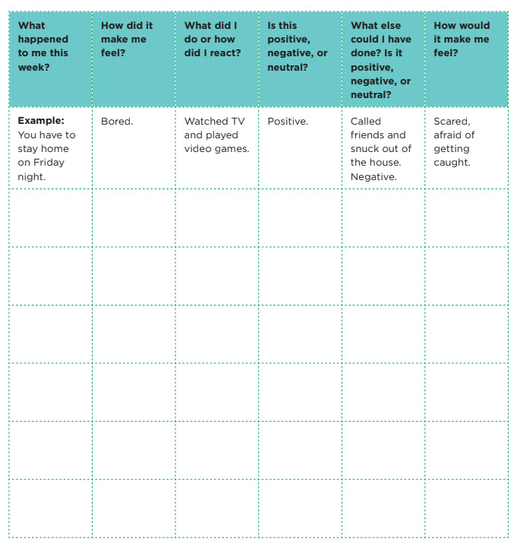
How Does It Make Me Feel?
Notes:
Step 3:
Tips:
Ask students to write their answers on a piece of paper. You can also give them the option to draw a quick picture of the scenario instead of writing it. They can also draw a “smiley face” that shows how the scenario made them feel.
Step 4:
Tips:
Have the students continue writing or drawing their answers on their piece of paper.
Step 5:
Tips:
If using Zoom, use the annotate feature to write or draw the situation. You can get one of the students to do this.
Step 6:
Tips:
Ask all of the students to show how they would feel in the situation by making a facial expression.
Step 7:
Tips:
Have the students continue writing or drawing their answers on their piece of paper.

Slide 9
What’s Your Reason?
You’re having fun with your friends and want to keep the fun going.
You want to be grown up.
You don’t want to follow rules anymore.
You are celebrating!
You are mad at somebody.
You are in emotional pain or are feeling down, and you want other people to know it.
You want to be cool.
You like to take risks.
You want to fit in.
You want to be like your friends.
You are under stress.
You are bored.
You want everyone to think you are bad, and then maybe they will respect you.
Notes:
Step 8:
Tips:
You can use this slide instead of the handout.

Slide 10
Activity
Notes:
Step 9:
Tips:
You can assign each of the groups a scenario. Tell the other students to mute their volume so that the first group can plan and discuss how they will act out the scenario. The first group will send a chat message that they are ready. Everyone will unmute the volume and watch the first group act out the scenario. Each group will take turns doing this. Make sure you are unmuted the whole time. Another option would be to discuss negative and positive reactions to the specific situations that the youth chose.
Step 10:
Step 11:

Slide 11
Family Corner / Community Corner
Notes:
Step 12:

Slide 12
This presentation was developed by North Carolina 4-H for use by the 4-H Health Rocks!® program and its trained facilitators. This content should only be used by those who are authorized by North Carolina 4-H and are trained to implement this program. If you are viewing this information and have not been trained in Health Rocks!®, please contact your local North Carolina 4-H Agent.
For questions regarding the NC 4-H programs, contact your local 4-H Agent.
Click here to find your county center!
For more information about NC 4-H Healthy Living programs, visit our website!
Click here to learn more about North Carolina 4-H Healthy Living.
For questions regarding content related to the NC 4-H Health Rocks!® program, contact the NC 4-H Healthy Living Coordinator.
Kenan Bridges
NC 4-H Healthy Living Coordinator
kbridge3@ncsu.edu

Slide 13
References
1. Lachmann-Anke, P., & Lachmann-Anke, M. (n.d.). [Animated person with question marks]. Pixabay. https://pixabay.com/illustrations/question-mark-consider-think-2318030/
2. Wokandapix. (n.d.). [Photograph of tennis shoes]. USA. Pixabay. https://pixabay.com/photos/run-running-sport-fitness-healthy-750466/
3. Webb, S. (n.d.). [Photograph of a person against a brick wall holding backpack]. London, Ontario, Canada. Unsplash. https://unsplash.com/photos/O0T1SIgHAfM
4. Mediamodifier. (n.d.). [Photograph of a person’s hands holding a clapboard]. Pixabay. https://pixabay.com/photos/clapper-hollywood-cinema-board-2140602/
5. Goldstein, A. (n.d.). The ballons [Photograph]. Tel-Aviv, Israel. Unsplash. https://unsplash.com/photos/Hli3R6LKibo

