Slide 2
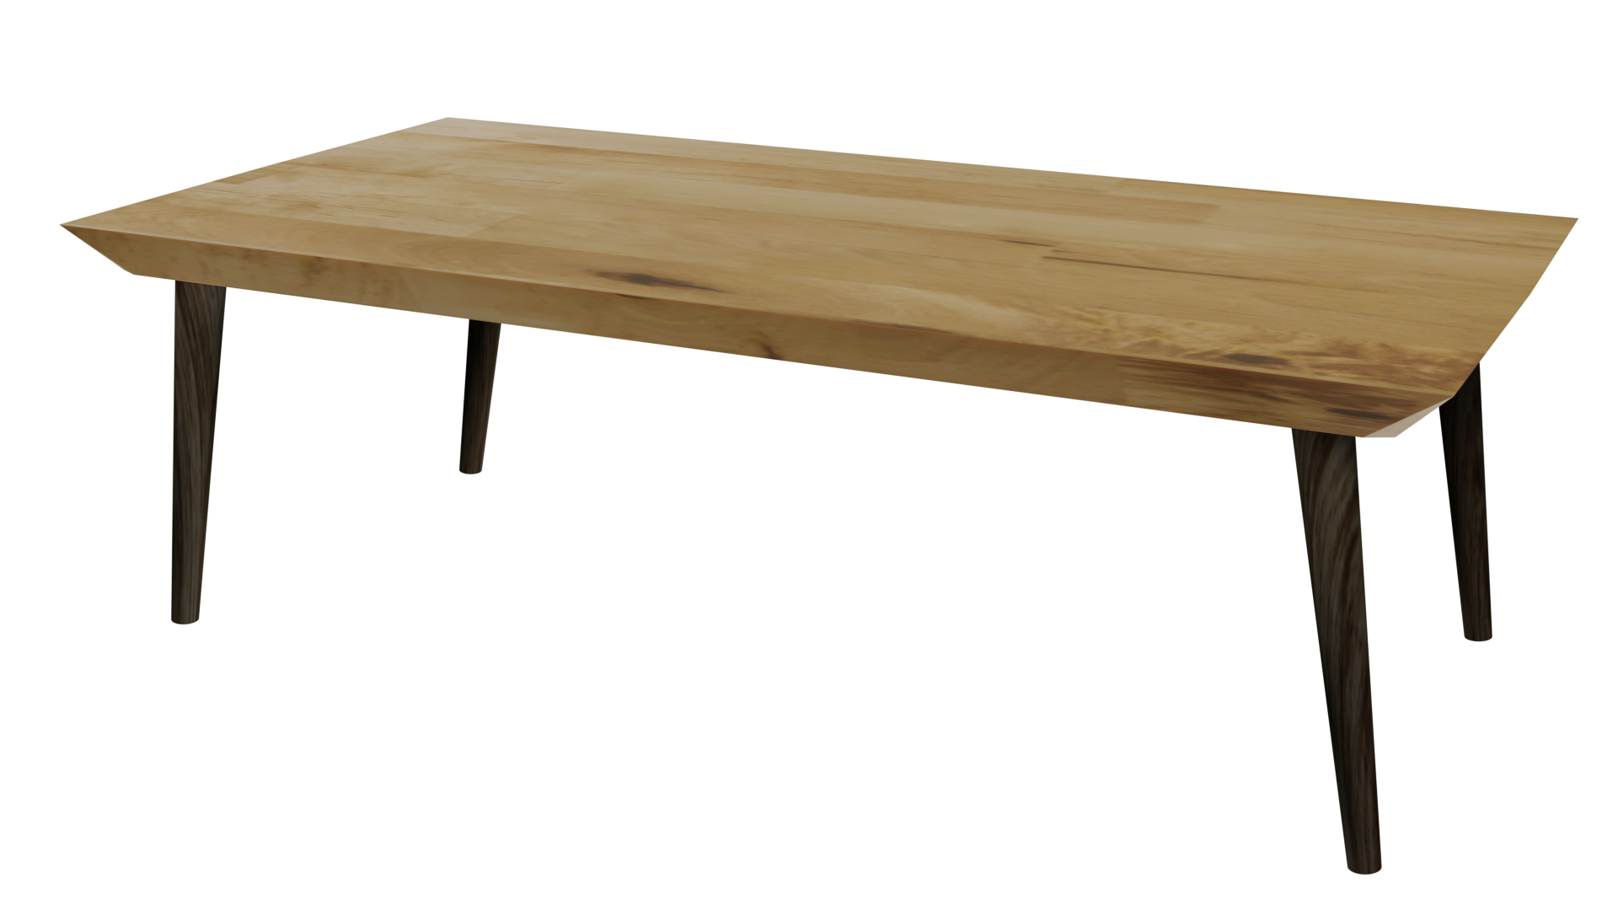
Videos
Welcome to
Worksheets

Slide 3
4-H Pledge
I pledge My Head to clearer thinking,
My Heart to greater loyalty,
My Hands to larger service,
& My Health to better living,
for my club, my community, my country, and my world.

Slide 4
Learn:
Today’s Lesson:
It’s More Than Just The Advertising
Activity:

Slide 5
Review
What did we learn last time?
Notes:
Step 1:

Slide 6
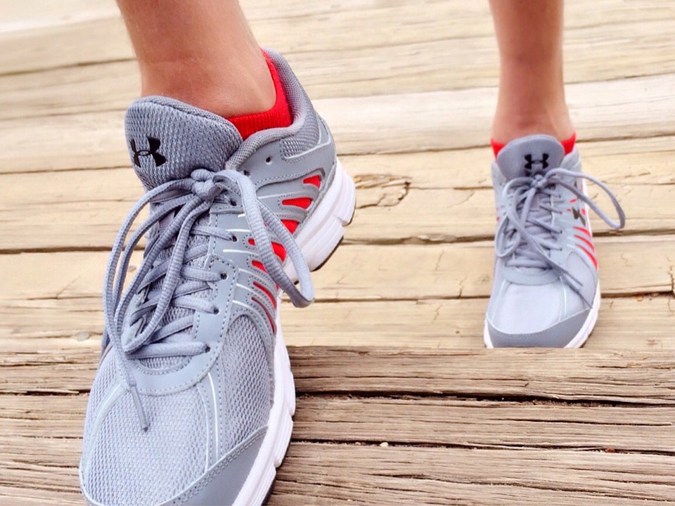
Warmup Time!
Notes:
To get students active at the beginning of the virtual lesson, choose one of the warm-ups from the list.

Slide 7
Time
Notes:
Step 2:

Slide 8
Who is Your Favorite Recording Artist/Group? What is Your Favorite Song?
Notes:
Step 3:
Tips:
If using Zoom, use the annotate feature to record the students’ responses.

Slide 9
Activity
Notes:
Step 4:

Slide 10
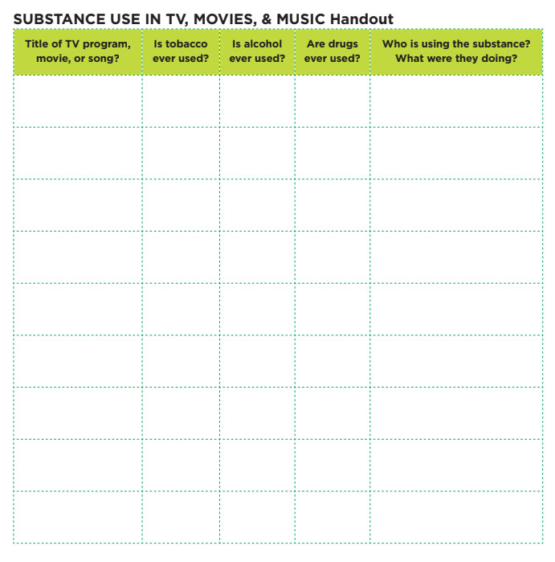
Lyric Activity
Notes:
Step 5:
Tips:
Do this activity as a whole group instead of dividing up into smaller groups. Go through the lyrics together, and have students answer aloud the questions on the Handout. Make sure that the songs chosen do not contain vulgar language. It might be a good idea for you to pick a few songs that the students may know ahead of time.
Step 6:

Slide 11
TV Show / Movie Activity
Notes:
Step 7:
Tips:
Due to the virtual setting, it would be better to do this activity individually.
Step 8:
Step 9:
Tips:
Students can write their answers on a blank piece of paper, or you can discuss the answers as a whole group.
Step 10:
Step 11:
Step 12:

Slide 12
Family Corner / Community Corner
Notes:
Step 13:

Slide 13
This presentation was developed by North Carolina 4-H for use by the 4-H Health Rocks!® program and its trained facilitators. This content should only be used by those who are authorized by North Carolina 4-H and are trained to implement this program. If you are viewing this information and have not been trained in Health Rocks!®, please contact your local North Carolina 4-H Agent.
For questions regarding the NC 4-H programs, contact your local 4-H Agent.
Click here to find your county center!
For more information about NC 4-H Healthy Living programs, visit our website!
Click here to learn more about North Carolina 4-H Healthy Living.
For questions regarding content related to the NC 4-H Health Rocks!® program, contact the NC 4-H Healthy Living Coordinator.
Kenan Bridges
NC 4-H Healthy Living Coordinator
kbridge3@ncsu.edu

Slide 14
References
1. Lachmann-Anke, P., & Lachmann-Anke, M. (n.d.). [Animated person with question marks]. Pixabay. https://pixabay.com/illustrations/question-mark-consider-think-2318030/
2. Wokandapix. (n.d.). [Photograph of tennis shoes]. USA. Pixabay. https://pixabay.com/photos/run-running-sport-fitness-healthy-750466/
2. Marcel, G. (n.d.). [Photograph of an hourglass]. Brussels, Belgium. Unsplash. https://unsplash.com/photos/Xd_H7iOwKN0
3. Mars, B. (n.d.). Music sounc [Photograph]. Budapest, Hungary. Unsplash. https://unsplash.com/photos/DBGwy7s3QY0
4. Muller, P. (n.d.). [Photograph of the audience’s hands in the air at a concert]. Eibergen, Netherlands. Unsplash. https://unsplash.com/photos/Fh-Q-xfdh_o
5. Leupe, J. (n.d.). Television on book shelf in living room [Photograph]. Bruges, Belgium. Unsplash. https://unsplash.com/photos/XE6PBDd7_FQ

