Slide 2
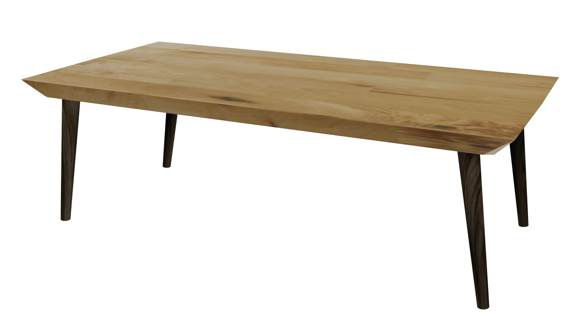
Videos
Welcome to
Worksheets

Slide 3
4-H Pledge
I pledge My Head to clearer thinking,
My Heart to greater loyalty,
My Hands to larger service,
& My Health to better living,
for my club, my community, my country, and my world.

Slide 4
Learn:
Today’s Lesson:
You Be
The Advertiser
Activity:

Slide 5
Review
What did we learn last time?
Notes:
Step 1:

Slide 6
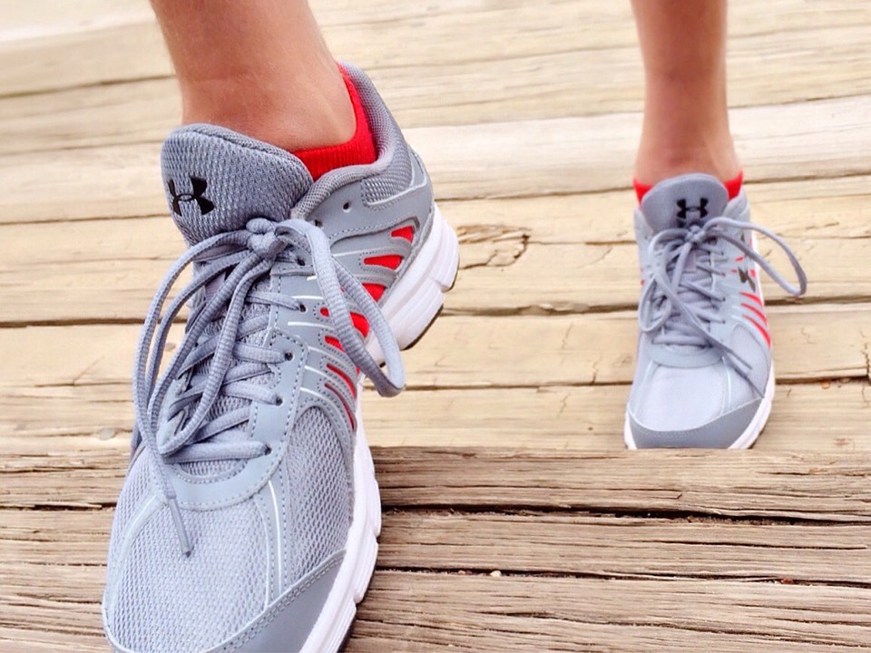
Warmup Time!
Notes:
To get students active at the beginning of the virtual lesson, choose one of the warm-ups from the list.

Slide 7
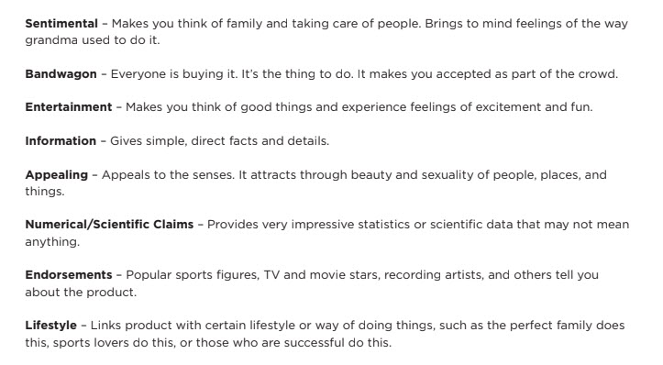
Activity
Notes:
Step 2:
Step 3:
[Modified Activity] Tell participants they are going to turn the tables and be the influencer. Youth will independently work as the marketer. The goal for each student is to convince their peers to buy or do what is being marketed. Each youth is to create a 20 to 30 second commercial, a 200 character tweet, a drawing of an advertisement, or a catchy slogan using the marketing techniques learned in Activity 7A. Youth will work independently and have 15 minutes to finish.
Tips:
This activity was modified from the original lesson so that students would have an opportunity to work independently and show their creativity.
Step 4:
[Modified Activity] Assign each student an item from the WHAT WE HAVE TO SELL ITEMS. Review the MARKETING TECHNIQUES USED IN ADVERTISING Handout with the students. Have them use the MARKETING GROUP Worksheet presented on the next slide to guide them in completing this activity.
Tips:
This activity was modified from the original lesson so that students would have an opportunity to work independently and show their creativity.
Here are the WHAT WE HAVE TO SELL ITEMS:
■ Jump off a cliff.
■ Stay awake for one week.
■ Swim the Atlantic Ocean.
■ Buy a trainload of toothpicks.
■ Eat a piece of rotten pizza.
■ Drink a gallon of paint.
■ Buy and wear clothes five sizes too big.
■ Buy a ticket for a trip to Mars.

Slide 8
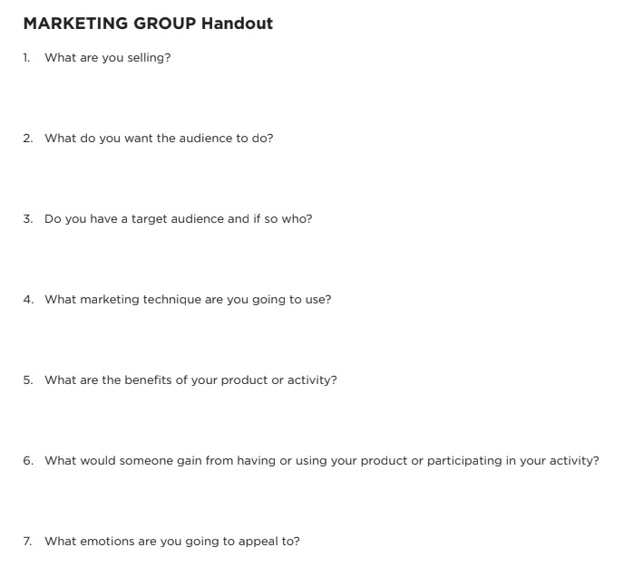
Activity
Notes:
Step 5:
[Modified Activity] Explain to participants that the items they are to market are outrageous and unbelievable. Companies and individuals in the marketing field sometimes use extreme ideas to set their product apart from others. Remind students they have 15 minutes to complete their commercial, tweet, advertisement, or slogan and will need to present their finished product before the group.
Tips:
This activity was modified from the original lesson so that students would have the option to choose an activity that would best suit their creativity.
Step 6:
[Modified Activity] As soon as each student has finished, everyone will get a chance to present their commercial, tweet, advertisement, or slogan. Youth will give positive feedback to each presenter.
Tips:
This activity was modified from the original lesson so that students would have an opportunity to work independently, show their creativity, and receive feedback in a positive way.
Step 7:
Step 8:
Step 9:
Step 10:

Slide 9
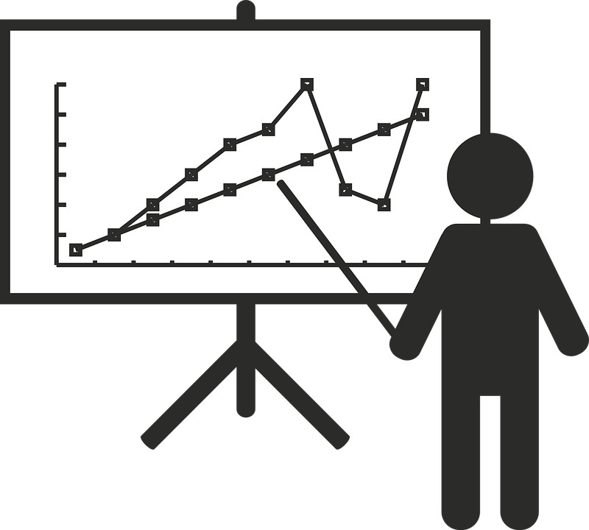
Family Corner / Community Corner
Notes:
Step 11:

Slide 10
This presentation was developed by North Carolina 4-H for use by the 4-H Health Rocks!® program and its trained facilitators. This content should only be used by those who are authorized by North Carolina 4-H and are trained to implement this program. If you are viewing this information and have not been trained in Health Rocks!®, please contact your local North Carolina 4-H Agent.
For questions regarding the NC 4-H programs, contact your local 4-H Agent.
Click here to find your county center!
For more information about NC 4-H Healthy Living programs, visit our website!
Click here to learn more about North Carolina 4-H Healthy Living.
For questions regarding content related to the NC 4-H Health Rocks!® program, contact the NC 4-H Healthy Living Coordinator.
Kenan Bridges
NC 4-H Healthy Living Coordinator
kbridge3@ncsu.edu

Slide 11
References
1. Lachmann-Anke, P., & Lachmann-Anke, M. (n.d.). [Animated person with question marks]. Pixabay. https://pixabay.com/illustrations/question-mark-consider-think-2318030/
2. Wokandapix. (n.d.). [Photograph of tennis shoes]. USA. Pixabay. https://pixabay.com/photos/run-running-sport-fitness-healthy-750466/
3. Treis, T. (n.d.). [Picture of a stick figure giving a presentation]. Bielefeld, Germany. Pixabay. https://pixabay.com/illustrations/presentation-data-office-networking-1559937/

