Slide 2
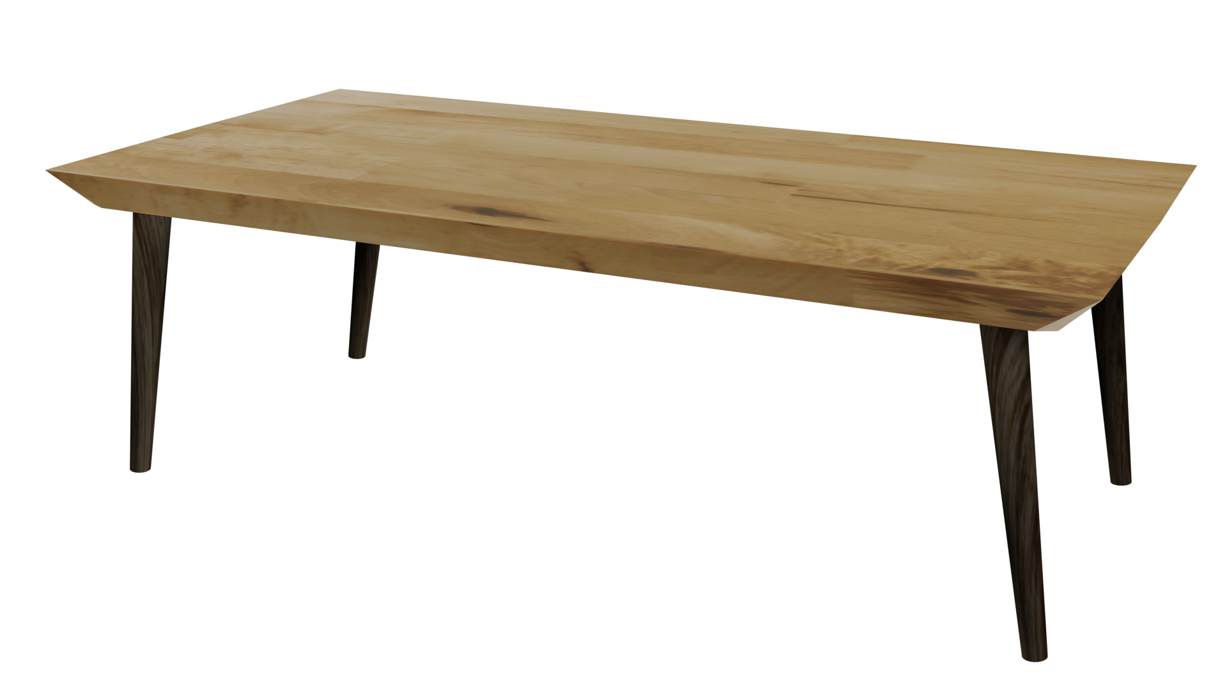
Videos
Welcome to
Worksheets

Slide 3
4-H Pledge
I pledge My Head to clearer thinking,
My Heart to greater loyalty,
My Hands to larger service,
& My Health to better living,
for my club, my community, my country, and my world.

Slide 4
Learn:
Today’s Lesson:
What Do I Do?
Activity:

Slide 5
Review
What did we learn last time?
Notes:
Step 1:

Slide 6
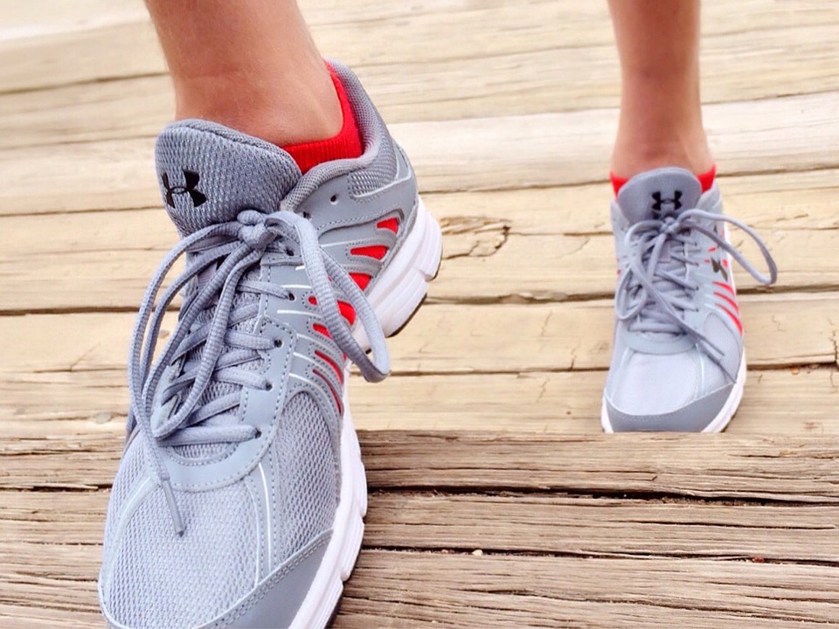
Warmup Time!
Notes:
To get students active at the beginning of the virtual lesson, choose one of the warm-ups from the list.

Slide 7
THE STORY OF JON
An Adventure Story
Notes:
Step 2:
Step 3:
Tips:
You need to manually click the choice you make for each slide.

Slide 8
This is a story about Jon – who recently moved to your town. Jon is 13 years old and misses his friends from his hometown. You have become good friends with Jon, but have noticed he doesn’t seem happy with his new home or school. Jon doesn’t participate in school activities and spends most of his time at home alone.

Slide 9
Jon has told you that he drinks beer at home alone after school just to pass the time and get rid of his lonely feelings. Jon’s attitude in school is bad and he doesn’t talk to anyone.
What do you do?
CHOICE A
Nothing
CHOICE B
Talk to an adult you trust
CHOICE C
Talk to Jon

Slide 10
Jon keeps drinking after school. He gets drunk alone almost every day, but now the “high” isn’t as much fun and he wants to find something that will give him a “better high.” Jon heard of some older kids who sell marijuana. He decides to buy some and starts to get high once a week, then 2-3 times a week. His grades are bad and he has flunked a couple classes. You notice he doesn’t want to be around friends anymore.
What do you do?
CHOICE A
Nothing
CHOICE B
Talk to Jon

Slide 11
Jon comes to school stoned all the time. He wants to find more and more “thrills,” so he has started to try other drugs. You have heard he has tried heroin, LSD and ecstasy. He’s wanting other young people to join him in this risky behavior. He’s always hanging around kids who are known drug users and dealers. He invites you to join him at a rave this weekend.
What do you do?
CHOICE A
Nothing
CHOICE B
Talk to Jon

Slide 12
Jon continues experimenting with drugs and becomes addicted to meth. He starts to beat his girlfriend. He flunks out of school at age 15. At age 16, he gets fired from his job and has no way to pay for drugs. He steals from his parents and siblings to get money to buy drugs. One weekend, he starts experimenting with lots of alcohol and drugs. The combination is deadly. He OD’s in his room at home and dies at age 16.
If only someone had taken the time to talk with Jon about his addiction 3 years ago …
Home

Slide 13
You tell a trusted adult – parent, teacher, counselor, clergy – what you have seen and heard about Jon. They realize it’s very important that someone helps Jon sooner rather than later. Together, you research how best you can help. This is a scary time for you, as well, as you know this “talk” will be difficult and you don’t know how your friend will react. You have doubts about what to do and what to say.
What do you do?
CHOICE A
Nothing
CHOICE B
Talk to Jon
CHOICE C
Let adult talk to Jon

Slide 14
There are many ways you can “talk” to Jon to let him know you care about him and want him to stop drinking and/or using drugs. As you did some research, you wrote down key talking points.
What do you do?
CHOICE A
Talk to Jon in the restroom in front of other friends
CHOICE B
Plan a time to meet with Jon privately
CHOICE C
Write Jon a hand-written note
CHOICE D
Send Jon an email

Slide 15
Jon denies there’s a problem and gets very mad. He screams that he hates you and doesn’t want to be your friend anymore. He storms out of the bathroom and doesn’t talk to you or look at you the rest of the day. He doesn’t look at you or talk to you all week.
What do you do?
CHOICE A
Nothing
CHOICE B
Talk to Jon again

Slide 16
Once you and Jon are alone, you talk to him about how he’s been acting. You don’t criticize but tell him you’re worried about what’s happening. You tell him you think he’s the greatest, but the alcohol and drugs seem to be changing the friend you know. You tell him you’d like to help him find a counselor to talk to and to help him. Jon could react in several ways. Two responses are below.
What do you do?
1.
Jon denies there’s a problem.
2.
Jon listens to what you say.

Slide 17
Jon doesn’t think he has a problem. He gets angry with you and doesn’t want to be your friend.
What do you do?
CHOICE A
Nothing
CHOICE B
Talk to Jon again
CHOICE C
Talk to adult

Slide 18
This time, Jon listens to your concerns. He admits he’s scared and doesn’t know what to do. He knows he has a problem, but he doesn’t feel there is anything he can do. He needs your help.
What do you do?
CHOICE A
Nothing
CHOICE B
Together you find Jon a counselor to talk to

Slide 19
Jon continued to see a counselor on a regular basis to help with his addiction. After months of drug and alcohol counseling, he started participating in school activities. He studied hard and made the Honor Roll almost every semester. At age 16, he became actively involved in the Teen Volunteer Program with his 4-H group, helping younger youth understand the dangers of alcohol and drug addiction, and sharing his personal story.
Thank you!

Slide 20
Jon receives your note. Although he may be a little angry and scared that someone has noticed, he realizes someone really cares. He’s scared about drinking again but you’re not sure what he plans to do.
What do you do?
CHOICE A
Nothing
CHOICE B
Talk to Jon in person

Slide 21
Jon receives your email. Although he may be a little angry and scared that someone has noticed, he realizes someone really cares. He’s scared about drinking again but you’re not sure what he plans to do.
What do you do?
CHOICE A
Nothing
CHOICE B
Talk to Jon another way

Slide 22
You realize that some ways of talking to Jon are better than others. You go online and find various websites that give you ideas on how best to talk with your friend. After researching and thinking about all this information …
What do you do?
CHOICE A
Nothing
CHOICE B
Talk to Jon

Slide 23
Some ways are better than others when it comes to talking to your friend about this sensitive issue.
What do you do?
CHOICE A
Talk to Jon in the restroom in front of other friends
CHOICE B
Plan a time to meet with Jon privately
CHOICE C
Write Jon a hand-written note
CHOICE D
Send Jon an email

Slide 24
Jon will probably not go ahead and get help, because it will be hard to admit he has a problem to a stranger and/or counselor. He could continue in the downward spiral of his addiction.
Downward spiral of addiction

Slide 25
You decide to talk with Jon in person and let him know you want to help him any way you can. Once the two of you are alone, you tell him how worried you are about what is happening and that you’ve talked with a trusted adult who also will help. You want him to know that you think he’s really a great guy but all the drugs seem to have changed him.
CHOICE A
Jon finds a counselor on his own
CHOICE B
Together you find Jon a counselor to talk to

Slide 26
The trusted adult talks with Jon and his parents. The trusted adult encourages you to talk to Jon as well.
What do you do?
CHOICE A
Talk to Jon
CHOICE B
Decide to let the adult help Jon.

Slide 27
Although you may not decide to talk with Jon yourself, you’ve made an important step in the right direction by talking to someone who can help Jon.
Thank you!

Slide 28
Jon thanks you, his friend, for having the courage to help change his life for the better.
Home

Slide 29
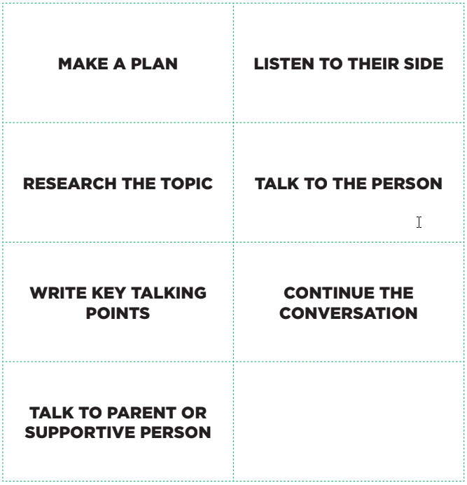
Steps For Helping A Friend Out
Notes:
Step 4:
[Modified Activity]: At the conclusion of THE STORY OF JON, tell participants they are going to take this activity a step further. Work as a class to complete this activity. Show the students the STEPS FOR HELPING A FRIEND Handout shown on this slide.
Tips:
This activity was modified so that it could be done in an online setting.
Step 5:
[Modified Activity]: Pick one of the steps from the STEPS FOR HELPING A FRIEND Handout, and use the annotate feature to write it so that the students can see.
Tips:
This activity was modified so that it could be done in an online setting.
Step 6:
[Modified Activity]: Have the students brainstorm about what they need to do in the selected step. If they were making a plan, what would they need to do? If they are researching the topic, what would youth need to know? Participants can base some of what they need to do on what they heard and saw in THE STORY OF JON. Do this for each of the steps on the STEPS FOR HELPING A FRIEND Handout.
Tips:
This activity was modified so that it could be done in an online setting.
Step 7:
[Modified Activity]: The group then needs to brainstorm and select the order of the steps. There is not a specific order, but a possible order is:
■ Make a plan.
■ Research the topic.
■ Write key talking points.
■ Talk to the person.
■ Listen to their side.
■ Continue the conversation.
■ Talk to a parent or supportive adult. (This one especially could go up after “Make a Plan” or anywhere else if youth think it is necessary.)
Tips:
This activity was modified so that it could be done in an online setting.
Step 8:
[Modified Activity]: After the group has placed the steps in order, use the annotate feature to record the order.
Tips:
This activity was modified so that it could be done in an online setting.

Slide 30
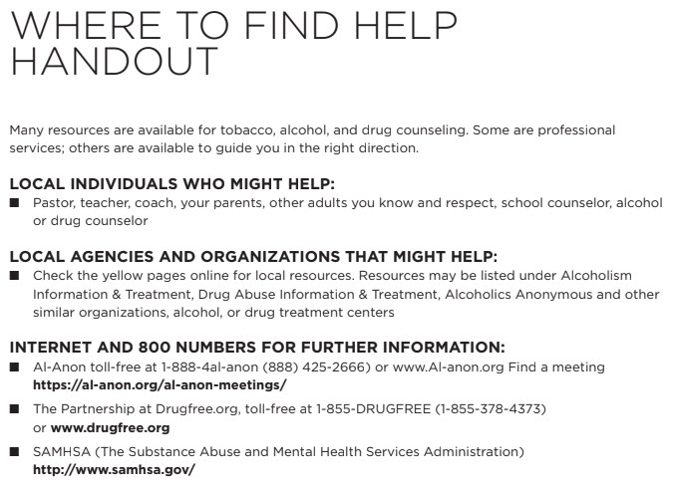
Notes:
Step 9:
[Modified Activity]:Show the WHERE TO FIND HELP Handout on this slide and review it. Although youth may not need it now, it provides them a possible resource in the future or to remember what was shared. Instruct students to write down some of these resources on a piece of paper.
Tips:
This activity was modified so that it could be done in an online setting without having the materials.
Step 10:
Step 12:
Tips:
[Note] There is a typo in the curricula. Step 12 will follow step 10.

Slide 31
Family Corner / Community Corner
Notes:
Step 13:

Slide 32
This presentation was developed by North Carolina 4-H for use by the 4-H Health Rocks!® program and its trained facilitators. This content should only be used by those who are authorized by North Carolina 4-H and are trained to implement this program. If you are viewing this information and have not been trained in Health Rocks!®, please contact your local North Carolina 4-H Agent.
For questions regarding the NC 4-H programs, contact your local 4-H Agent.
Click here to find your county center!
For more information about NC 4-H Healthy Living programs, visit our website!
Click here to learn more about North Carolina 4-H Healthy Living.
For questions regarding content related to the NC 4-H Health Rocks!® program, contact the NC 4-H Healthy Living Coordinator.
Kenan Bridges
NC 4-H Healthy Living Coordinator
kbridge3@ncsu.edu

Slide 33
References
1. Lachmann-Anke, P., & Lachmann-Anke, M. (n.d.). [Animated person with question marks]. Pixabay. https://pixabay.com/illustrations/question-mark-consider-think-2318030/
2. Wokandapix. (n.d.). [Photograph of tennis shoes]. USA. Pixabay. https://pixabay.com/photos/run-running-sport-fitness-healthy-750466/
3. Brown, A. (n.d.). Young people in conversation [Photograph]. Los Angeles, CA. Unsplash. https://unsplash.com/photos/-Xv7k95vOFA

