Slide 2
Videos
Welcome to
Worksheets

Slide 3
4-H Pledge
I pledge My Head to clearer thinking,
My Heart to greater loyalty,
My Hands to larger service,
& My Health to better living,
for my club, my community, my country, and my world.

Slide 4
Learn:
Today’s Lesson:
Sharing What I Know
Activity:

Slide 5
Review
What did we learn last time?
Notes:
Step 1:

Slide 6
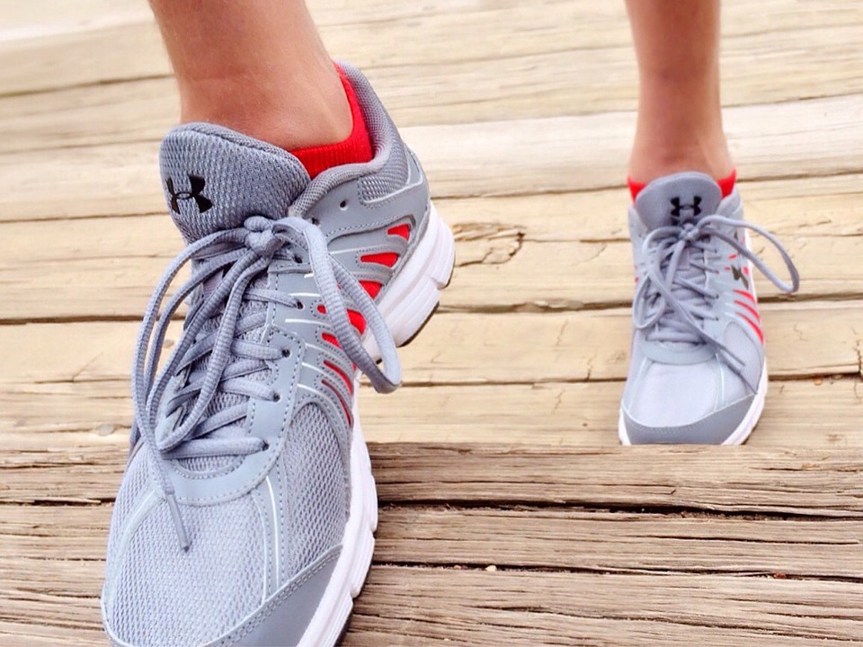
Warmup Time!
Notes:
To get students active at the beginning of the virtual lesson, choose one of the warm-ups from the list.

Slide 7
How can we Make a Difference in Our Community?
Notes:
Step 2:
Step 3:
Tips:
If using Zoom, you can use the annotate feature instead of using a dry erase board or flipchart.

Slide 8
Community Service Project Ideas
Contact organizations that work with tobacco, alcohol, and/or other drug education to obtain drug free pamphlets, posters, etc. and distribute them in various places around the community.
Make posters with prevention messages about tobacco, alcohol, and/or other drugs. Display the posters in public places.
Conduct a tobacco, alcohol, and/or other drug free night and use some of the activities form the Health Rocks!® project.
Teach a couple of the Health Rocks!® lessons to younger groups in the community.
Hold a fundraiser for creating a drug-free community activity.
Develop a drug prevention website for the community.
Create a series of social media posts that showcase the signs and symptoms of drug abuse.
Notes:
Step 4:
Tips:
Use this slide so that you do not have to annotate this information. Encourage youth to think about how some of these ideas could be done virtually.
Step 5:
Tips:
Make sure everyone’s opinion is heard. If needed, consider voting to decide which idea will be used as the community service project. If using Zoom, you can create a poll with Zoom so that students can vote on their favorite. Directions to do that can be found at the following links:
https://www.youtube.com/watch?v=HDHRmvpUVXw
https://support.zoom.us/hc/en-us/articles/203749865-Polling-for-webinars

Slide 9
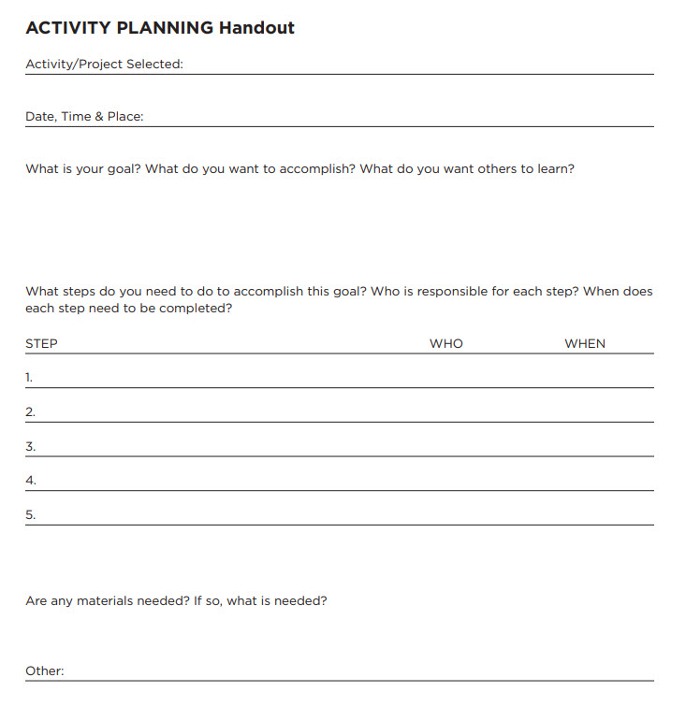
Activity Planning Handout
Notes:
Step 6:
Tips:
Have the students write the planning steps on a piece of paper.

Slide 10
Let’s Celebrate!
Notes:
Step 7:
Tips:
If you decide to conduct a celebration, you can turn on music and have students dance and celebrate. Tell them to grab a snack (if they want) to celebrate.
Step 8:

Slide 11
This presentation was developed by North Carolina 4-H for use by the 4-H Health Rocks!® program and its trained facilitators. This content should only be used by those who are authorized by North Carolina 4-H and are trained to implement this program. If you are viewing this information and have not been trained in Health Rocks!®, please contact your local North Carolina 4-H Agent.
For questions regarding the NC 4-H programs, contact your local 4-H Agent.
Click here to find your county center!
For more information about NC 4-H Healthy Living programs, visit our website!
Click here to learn more about North Carolina 4-H Healthy Living.
For questions regarding content related to the NC 4-H Health Rocks!® program, contact the NC 4-H Healthy Living Coordinator.
Kenan Bridges
NC 4-H Healthy Living Coordinator
kbridge3@ncsu.edu

Slide 12
References
1. Lachmann-Anke, P., & Lachmann-Anke, M. (n.d.). [Animated person with question marks]. Pixabay. https://pixabay.com/illustrations/question-mark-consider-think-2318030/
2. Wokandapix. (n.d.). [Photograph of tennis shoes]. USA. Pixabay. https://pixabay.com/photos/run-running-sport-fitness-healthy-750466/
3. Busing, H. (n.d.). Girl friends hands piled together [Photograph]. Decatur, AL. Unsplash. https://unsplash.com/photos/Zyx1bK9mqmA
4. Roven Images. (n.d.). New year’s eve fireworks in the sky [Photograph]. Unsplash. https://unsplash.com/photos/HxeBUWUiA1A

